Slide 1



Year 6 Transition 2020
Geographical Skills
PUPIL NAME
_____________________________________________________________

Slide 2


What is Geography?
Activity 1
Video Link:
https://www.youtube.com/watch?v=SM4Q4yuSUPk
What is Geography?
Watch the video link above and then create a spider diagram using images to show what the study of Geography is about.

Slide 3



What is Geography?
Activity 2
Geography comes from the ancient Greek word ‘geo’ meaning ‘earth’. Geography is the study of the world. There are three different parts of Geography that we study:
Physical Geography which is the study of things that humans have no control over such as weather or earthquakes.
Human Geography which is the study of how human beings have affected the earth’s surface such as cities or transport.
Environmental Geography is the study of how humans have affected the environment. This can be in both positive and negative ways such as planting trees or causing global warming.
Physical | Human | Environmental
Volcano | Roads | Global Warming
Complete the table above by adding examples of physical, human and environmental Geography.

Slide 4
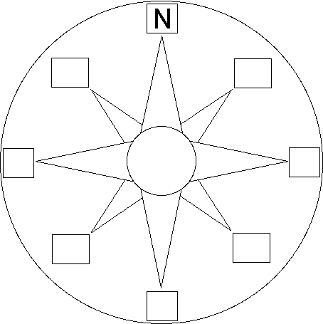
The Compass
Activity 3
A compass is an important tool for map readers. It tells you which way is north and where to find east, south and west. Together, these are known as the four cardinal points of the compass. However, there are four other points of the compass. These fall between the four cardinal points of the compass. These are known as ordinal points of the compass.
Answer these questions below:
What is a compass?
What is a compass used for?
Name a device on which a compass can be found.
Complete the eight points on the compass below.

Slide 5
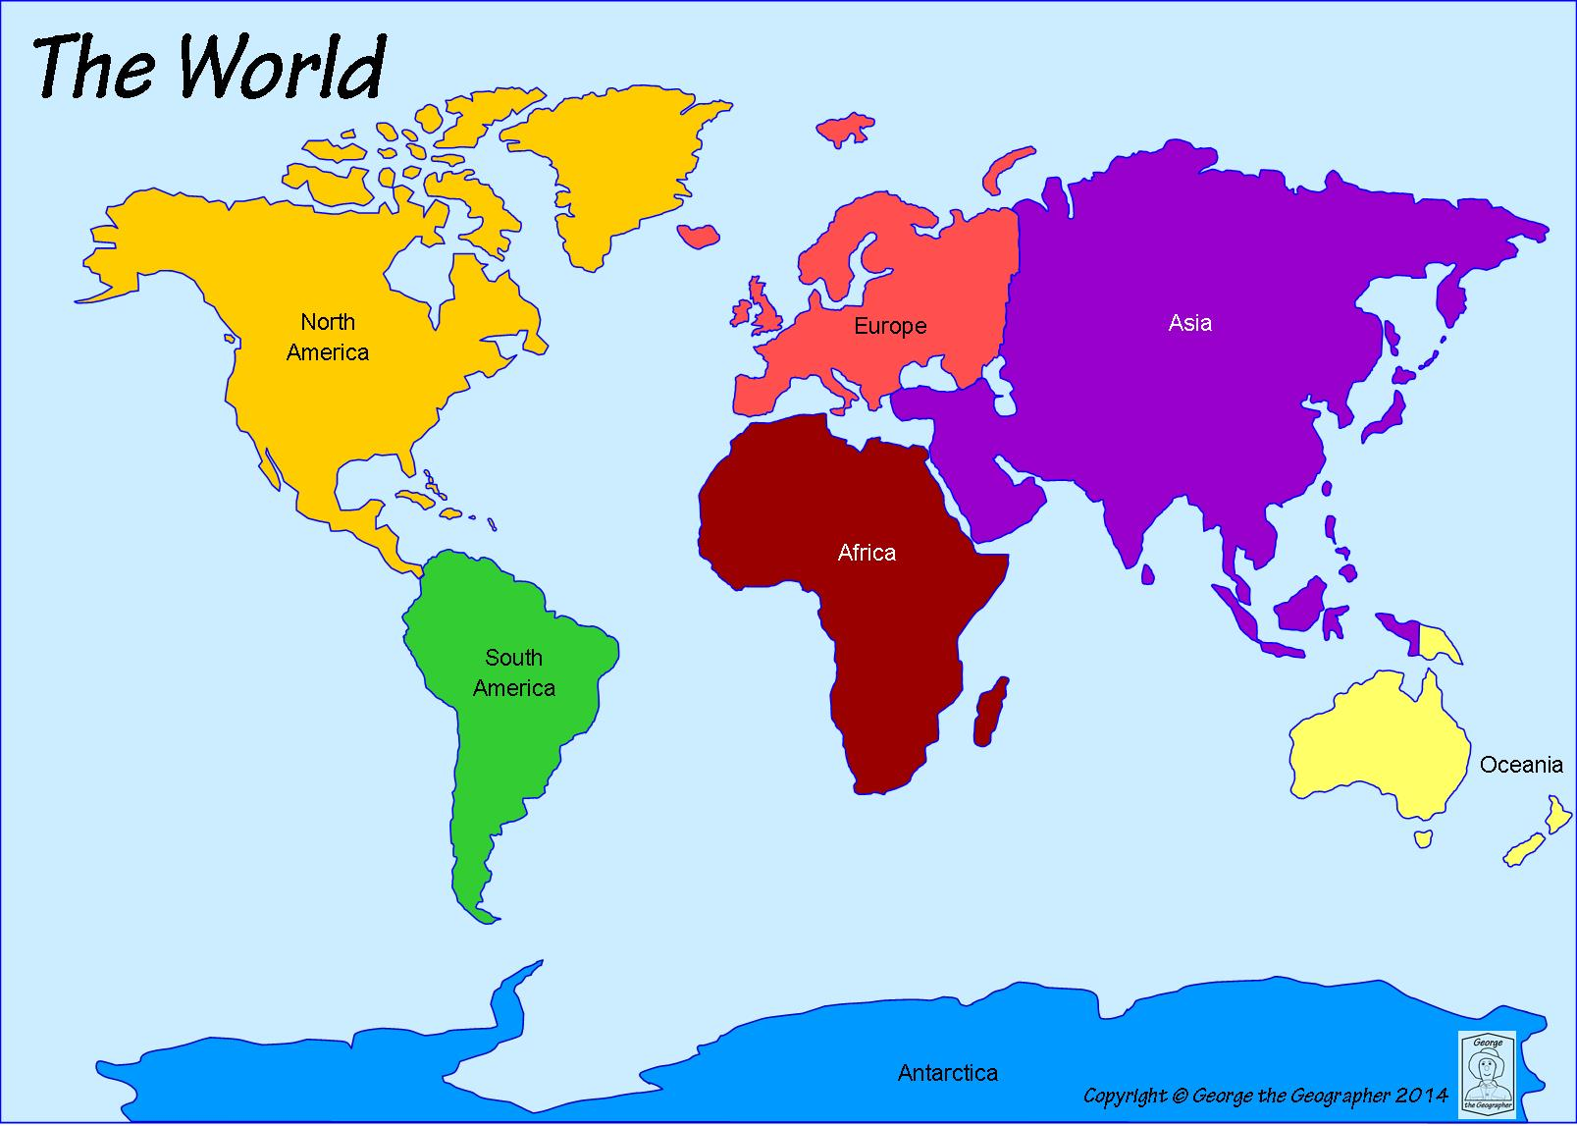
The Compass
Activity 4
Use the eight point compass to give detailed directions to the questions below:
What direction do I need to travel from Oceania to Asia?
What direction do I need to travel from Africa to South America?
What direction do I need to travel from Africa to Europe?
What direction do I need to travel from Antarctica to Asia?

Slide 6
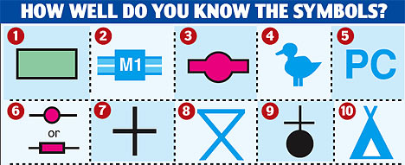
Map Symbols
Activity 5
A map is a representation of places which can show Physical or Human Geography. Maps were often on paper however now maps are electronic and can be used on phones and tablets. All maps use symbols. Symbols are used so we can show different features on maps. Map symbols are the same on all maps.
Answer these questions below:
What is a map symbol?
What are map symbols used for?
Why are map symbols used?
Are map symbols used on all maps?
How has the presentation of maps changed over recent years?
Challenge: can you identify another 10 symbols?
Identify the map symbols shown above:
1.
2.
3.
4.
5.
6.
7.
8.
9.
10.

Slide 7
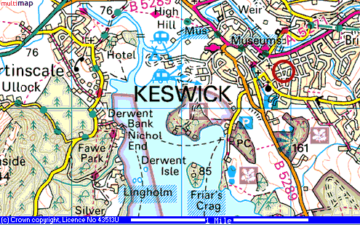
Map Symbols
Activity 6
Study the Ordnance Survey map of Keswick. What do the following symbols mean?
The blue letter ‘P’
The blue caravan
The black plus sign
The brown leaf
The yellow road
The letters ‘PC’
What evidence can you find on the map to show that Keswick gets lots of tourists?
The map above which shows a section of an Ordnance Survey map of Keswick.
Ordnance Survey are the UK’s official map makers.

Slide 8

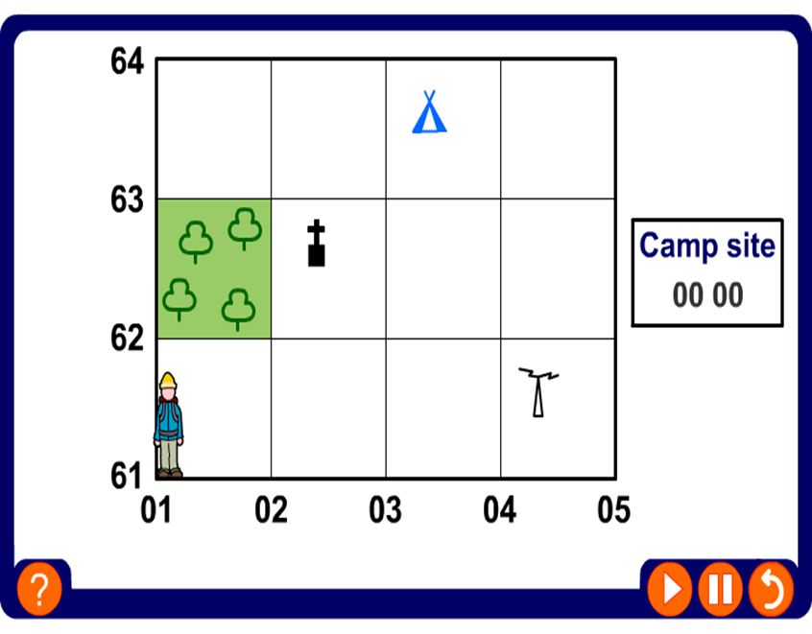
Grid References
All maps have lines which go up them and across them. These lines create a grid on the map. Lines which go across the map are known as Eastings. Lines which go up the map are known as Northings. These lines all have numbers. This means that every square on the map has its own unique number. This allows us to locate things on a map easily. To locate something on a map you must use the Easting number first.
We remember this by the phrase along the corridor and then up the stairs.
Lets have a look at how this works. We will find the four figure grid square for the church with a tower.
Firstly go along the Easting line and write down the number of the square. In this case it is 02.
Now go up the Northings and write down the number of the square. In this case it is 62.
Combine the two sets of numbers to give the four figure grid square.
The grid square for the church with a tower is 02,62

Slide 9

Grid References
Activity 7
27
Give the correct grid reference for the following map symbols:
PC
26
PO
25
24
23
04
05
06
07
08
09
PC

Slide 10
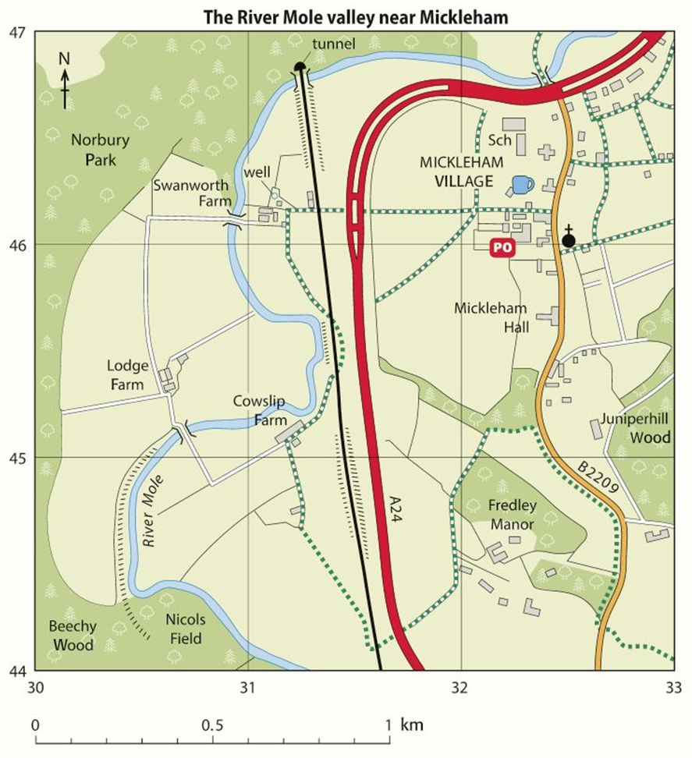
Grid References
Activity 8
Choose the correct answer by using the map extract to give the correct four figure grid reference for:
The School: A) 3246 B) 3346 C) 3145
The Lodge Farm: A) 3044 B) 3045 C) 3046
Fredley Manor: A) 3144 B) 3244 C) 3245
Cowslip Farm: A) 3145 B) 3146 C) 3245
The Well: A) 3045 B) 3344 C) 3146

Slide 11
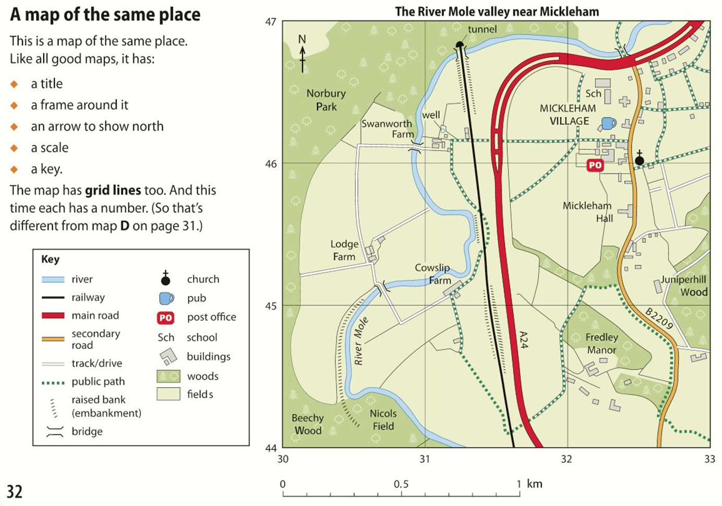
Grid References
Here is an OS map of the same place as the aerial photograph was taken. The map has far more detail on it.
Give the four figure grid reference for the school in Mickleham village.
This is a simple task. The answer is 32,46.
Each of the grid squares on this map are 4km2. This is a large area and may cause problems.
Imagine a child is injured at the school and an air ambulance helicopter is searching for the school in this large area.
How might this be a problem?
How could we give the pilot a more accurate set of grid references to help locate the school more quickly?

Slide 12
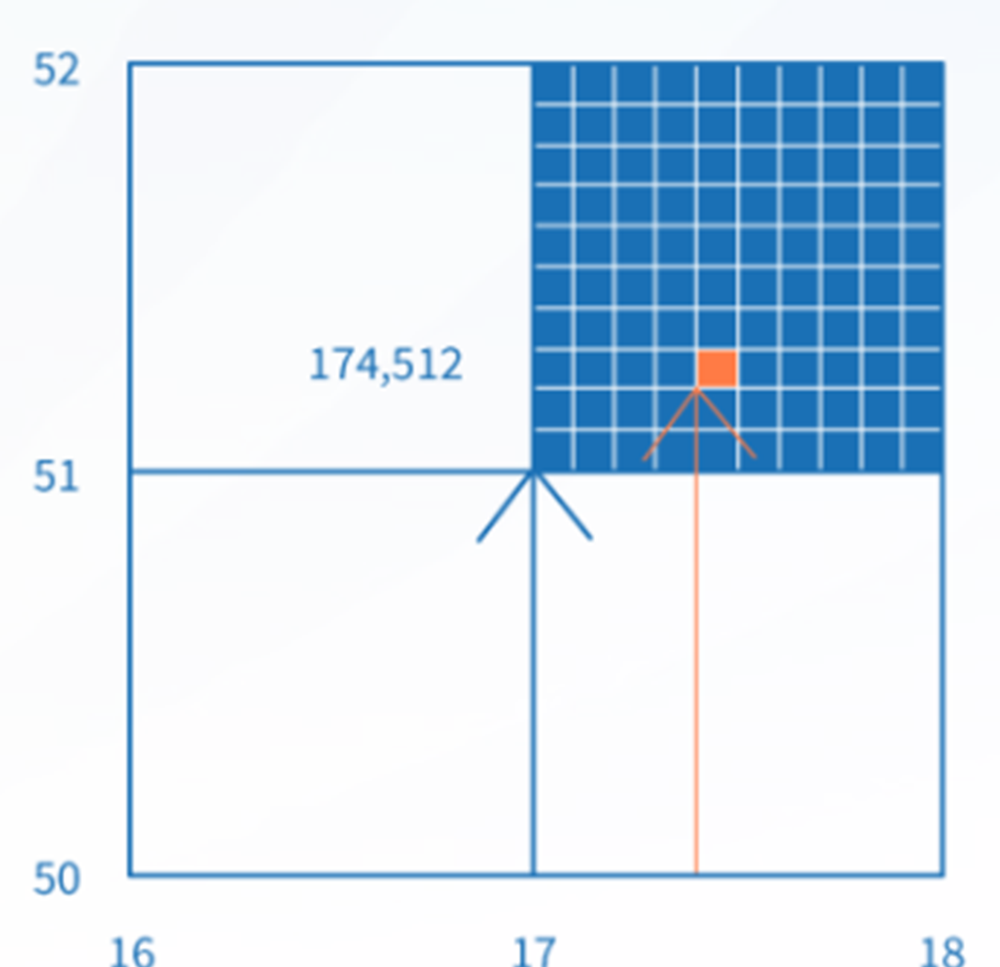
Grid References
The answer is by using adding one number to each of the sets of coordinates. This gives us six figure grid references.
If we need to be more accurate with the grid references we give. By dividing each grid square by ten vertically and horizontally the square now been to divided into one hundred smaller squares.
By adding an extra number (between 1 and 10) to the easting and the northing, you'll come up with a six-figure reference that pinpoints a place to within 100 metres on the map.
So the four figure grid reference for the blue square is 17 51.
Now to pinpoint the orange square we add a number (digit) to each set of coordinates.
Use the Eastings first. (along the corridor)
174
Now the Northings. (up the stairs)
512
So the six figure grid reference is 174 512

Slide 13

Grid References
Activity 9
Give the six figure grid references for:
School at Mickleham village:
Lodge Farm:
The bridge south of Lodge Farm:
The church in Mickleham:
The tunnel south east of Mickleham:

Slide 14
Field Sketches
Field sketches are pencil drawings of real-life geographical features. Follow this quick step guide to create the perfect field sketch:
Identify the landscape that needs to be sketched.
Write a title that will help to locate the sketch.
Draw an outline of the main features of the landscape with a pencil, e.g. hills and valleys or buildings and roads.
Add detail to the sketch to record more information, e.g. river features, such as meanders, river cliffs and rapids. Only draw people if they are important to the enquiry question.
Annotate or label the field sketch to give more information about the landscape and conditions, e.g. what was the weather like?

Slide 15
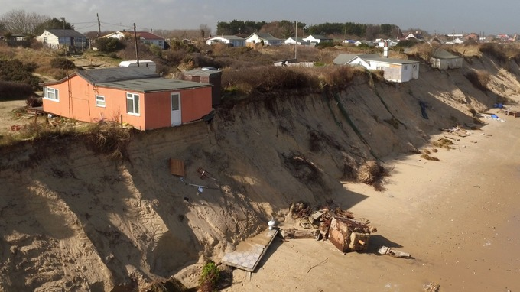
Field Sketches
Activity 10
This photograph shows coastal erosion and how houses at the coast are at risk of falling into the sea due to the process.

Slide 16
Field Sketches
Activity 10
Draw a field sketch of the photograph on the last slide in the space provided below:
Remember to give your sketch a title and label the key features.

