Slide 1
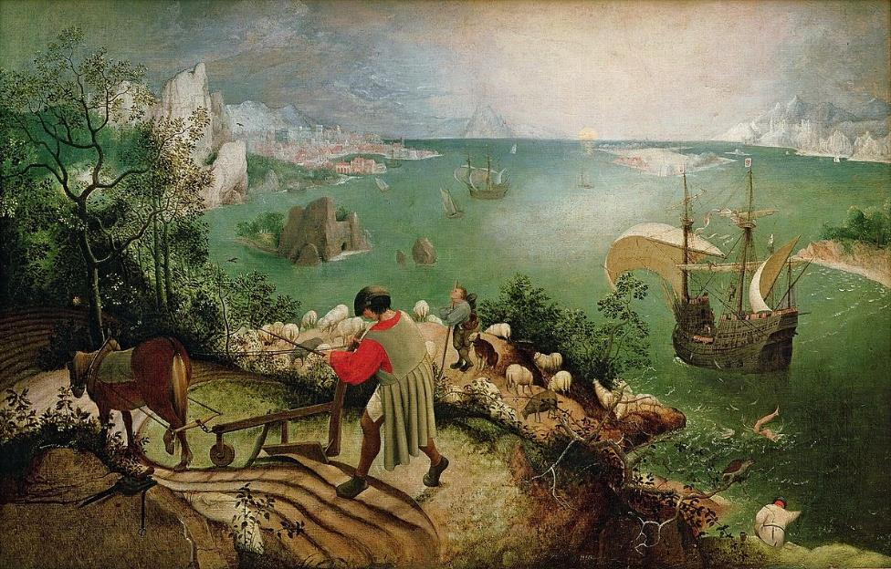
2 minutes to write down:
What can you see?
What might be happening in this picture?
What myth might it be depicting?

Slide 2
The Fall of Icarus
Did you spot him?

Slide 3
The Fall of Icarus
Did you spot him?

Slide 4
The Fall of Icarus
Did you spot him?
Let’s read the story of Icarus now.
As we read, think about how the story makes you feel.
When we’ve finished reading, choose an emoji to show how you feel about the story and try to give a reason why you think you feel that way.

Slide 5
What’s interesting about the viewpoint here? Where is your eye drawn?
Do any of the other people in the painting seem to have noticed Icarus?

Slide 6
The Fall of Icarus
We’re going to think about viewpoint in relation to this famous story by reading two different versions.
As you listen, think about why the writer might have chosen to adopt the different viewpoints in their telling of this very famous story.

Slide 7
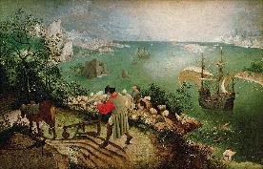
The Fall of Icarus
By Carol Ann Duffy
And Ovid:
Mrs Icarus
I’m not the first or the last
to stand on a hillock,
watching the man she married
prove to the world
he’s a total, utter, absolute, Grade A pillock.
‘the boy Icarus began to enjoy the thrill of swooping boldly through the air. Drawn on by his eagerness for the open sky, he left his guide and soared upwards, till he came too close to the blazing sun and it softened the sweet-smelling wax that bound his wings together. The wax melted. Icarus moved his bare arms up and down, but without their feathers they had no purchase on the air. Even as his lips were crying his father’s name, they were swallowed up in the deep blue waters which are called after him. The unhappy father, a father no longer, cried out: “Icarus! Icarus,” he called. “Where are you? Where am I to look for you?” As he was still calling “Icarus” he saw the feathers on the water, and cursed his inventive skill.’
Answer these questions in full sentences.
Is one version of the story more interesting for you? Why or why not?
How does each telling of the story make is feel towards Icarus?
Is there another viewpoint the story could be told from that might be more interesting to you?
Which telling did you like best?

Slide 8
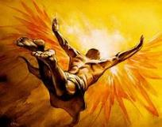
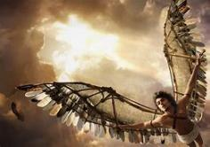
The Fall of Icarus
Below is a choice of three tasks you could complete inspired by the work we have done so far this lesson. Choose one that you will complete now.
Retell the story of the Fall of Icarus from the viewpoint of Daedalus, Icarus’ father, who sees the whole thing happen.
Use Ovid’s version of the story to help you, if you need to.
Retell the story of the Fall of Icarus, from his viewpoint, thinking about what might have made him want to fly so close to the sun.
You might want to use one of the pictures below to help you.
Retell the story of the fall of Icarus from an outsider’s viewpoint, in the form of a poem, picture or storyboard.
You might want to use the picture from the start of our lesson to hep you.

Slide 9
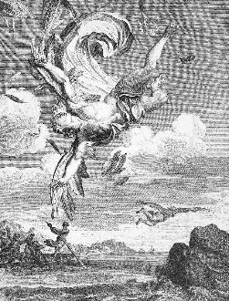
The Fall of Icarus
Today’s final question is this:
Although we’ve explored the story of Icarus from a number of different viewpoints today, do you think they all share the same moral or lesson?
Give a reason for your answer.

