Slide 1
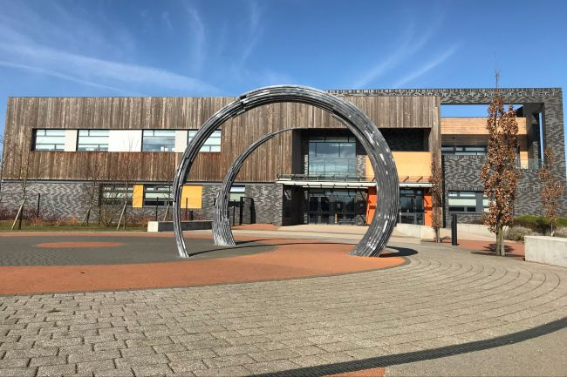
Welcome Year 6
Each day there will be a variety of taster lessons for you to work through. These will all be collated onto one power point with links to the different materials.
There will also be a couple of pastoral sessions from your Head of Year to introduce you to the school and for us to get to know you.
Please complete as much as you can. If you are struggling with anything please don’t worry- just do as much as you can.

Slide 2

Monday 22nd June
1. Pastoral activity – Tour and Intro
2. English
3. Geography
4. PE
Optional extra:
Music

Slide 3

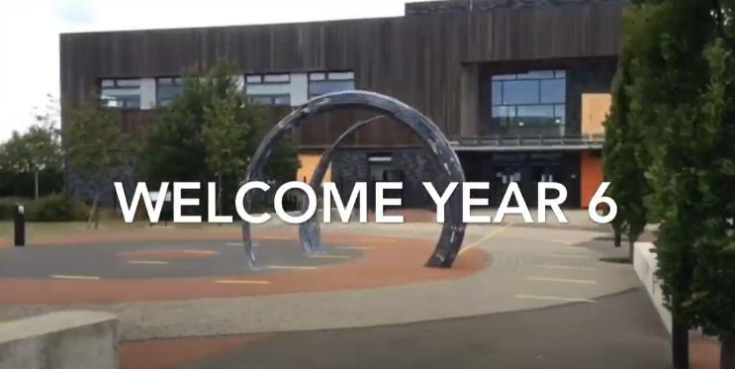
Monday 22nd June
1. Tour and Intro
Tour of school and meet the year team:
https://www.youtube.com/watch?v=BXjXFurAT9o

Slide 4
Monday 22nd June
2. English
Meet the English department:
https://www.loom.com/share/06be8bc8c750424b9da5b411053ab6f8
Introductory lesson:
https://www.loom.com/share/3f89e0d8337c4c82ba640510734ce9ed
Other resources you may need:
‘Monday 2. English Intro lesson’ PowerPoint or PDF
‘Monday 2. English Intro lesson’ Word document

Slide 5
Monday 22nd June
3. Geography
Open the PowerPoint or PDF ‘Monday 3 Geography’

Slide 6

Monday 22nd June
4. PE
Year 6 Transition Sports Week
Click here to find out more….
Remember to click on each challenge each day to find out how to complete it, then click on the link below each day to log your efforts.
Monday’s timetable on the next slide

Slide 7



Year 6 Transition Sports Week
Every time you complete an activity, click the link and complete the form to log your efforts. Every activity you complete and log will give you 10 points. Prizes are on offer for: the Year 6 with the most points from each school, the Year 6 with the best scores across each activity, the top school with most entries in Year 6. | MONDAY |  |  | Throughout the whole week, while you are completing your challenges and if you go out on a walk, run or bike ride, take a photo or a selfie and get your parent, carer or guardian to email cam-healthyselfie@cambournevc.org If you would like to be in our twitter collage. It must be from your parent’s email address, with their permission. @CamVC_PE
 | Multiskills (click on the challenge names below to find out more about each one)
 | Keepy Uppies | Lateral Jumps | Step Ups
 | CLICK THIS LINK TO REGISTER YOUR RESULTS FOR MONDAY

Slide 8
Monday 22nd June
Optional extra: Music
We’re really looking forward to you joining Cambourne Village College – and teaching you in Music.
We also hope that you might get involved in some of the choirs, bands, orchestras, and productions that we have going on!
There will be 3 optional musical activities this week. You don’t have to any of them, or you might want to do all of them! But if you are able to send us some work, we looking forward to looking at it!

Slide 9
Monday 22nd June
Optional extra: Music
Activity 1: Musical Performance
If you already play an instrument, we’d love you to make an audio recording (not video) of you playing a piece on your instrument.
It can be any piece you like!
If you’re a singer, we’d love you to send us a recording of your favourite song.
Once you have made your recording, ask your parents to email it to Mr Page (gpage@cambournevc.org)
Make sure the email includes your name! You might want to tell me a little about the piece / song you chose.

