Slide 1
How to Search & Apply
Guide for Learners v2.0

Slide 2
Notes:
Open a browser and navigate to the site, the address is xxxxxx Our site may look a little different to this but the process is the same.
[click] From the homepage you need to click on Log In

Slide 3
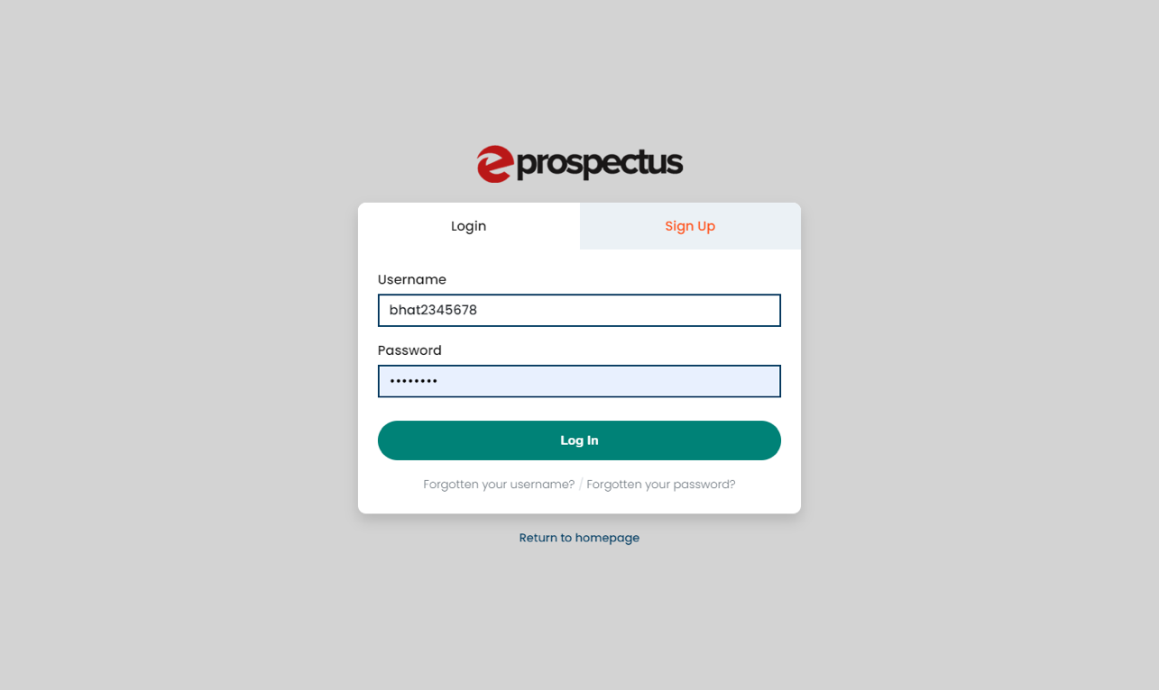
Notes:
[click] You then need to enter the username and password details you have been/will be given.
[click] Then click the Login button.

Slide 4
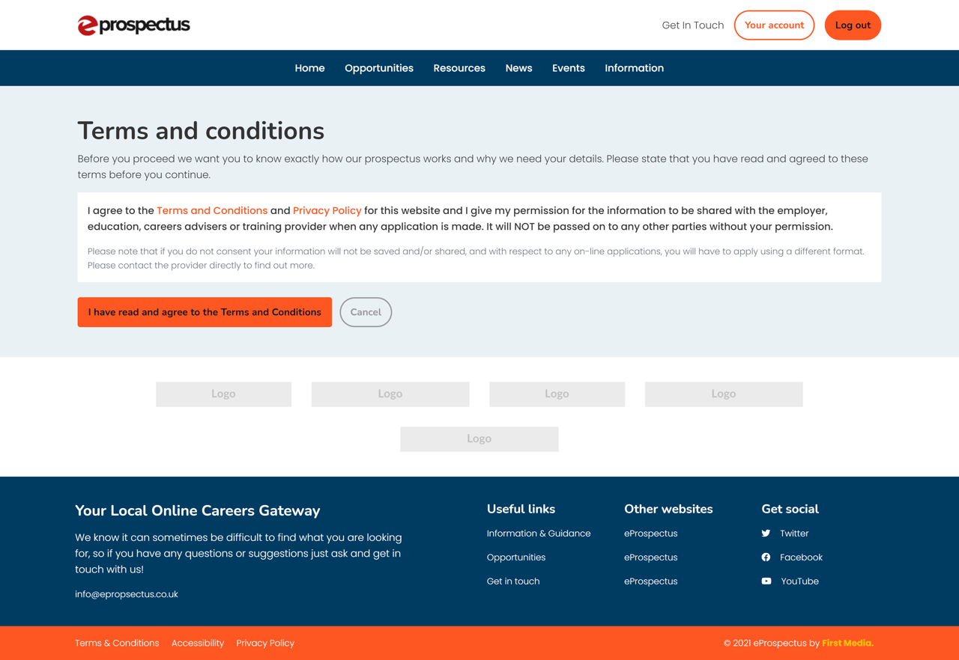
Notes:
Read the terms and conditions.
[click] Then click on the Agree button.

Slide 5
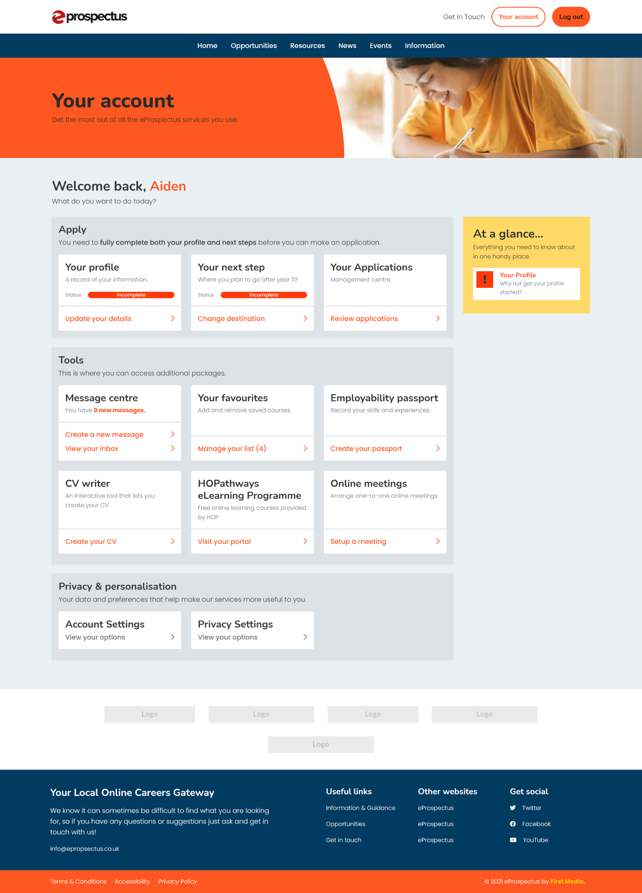
Notes:
This is the Your Account page where you can review your template and make applications.
We are going to start by filling in our profile.
[click] To do this click on the Your Profile button

Slide 6
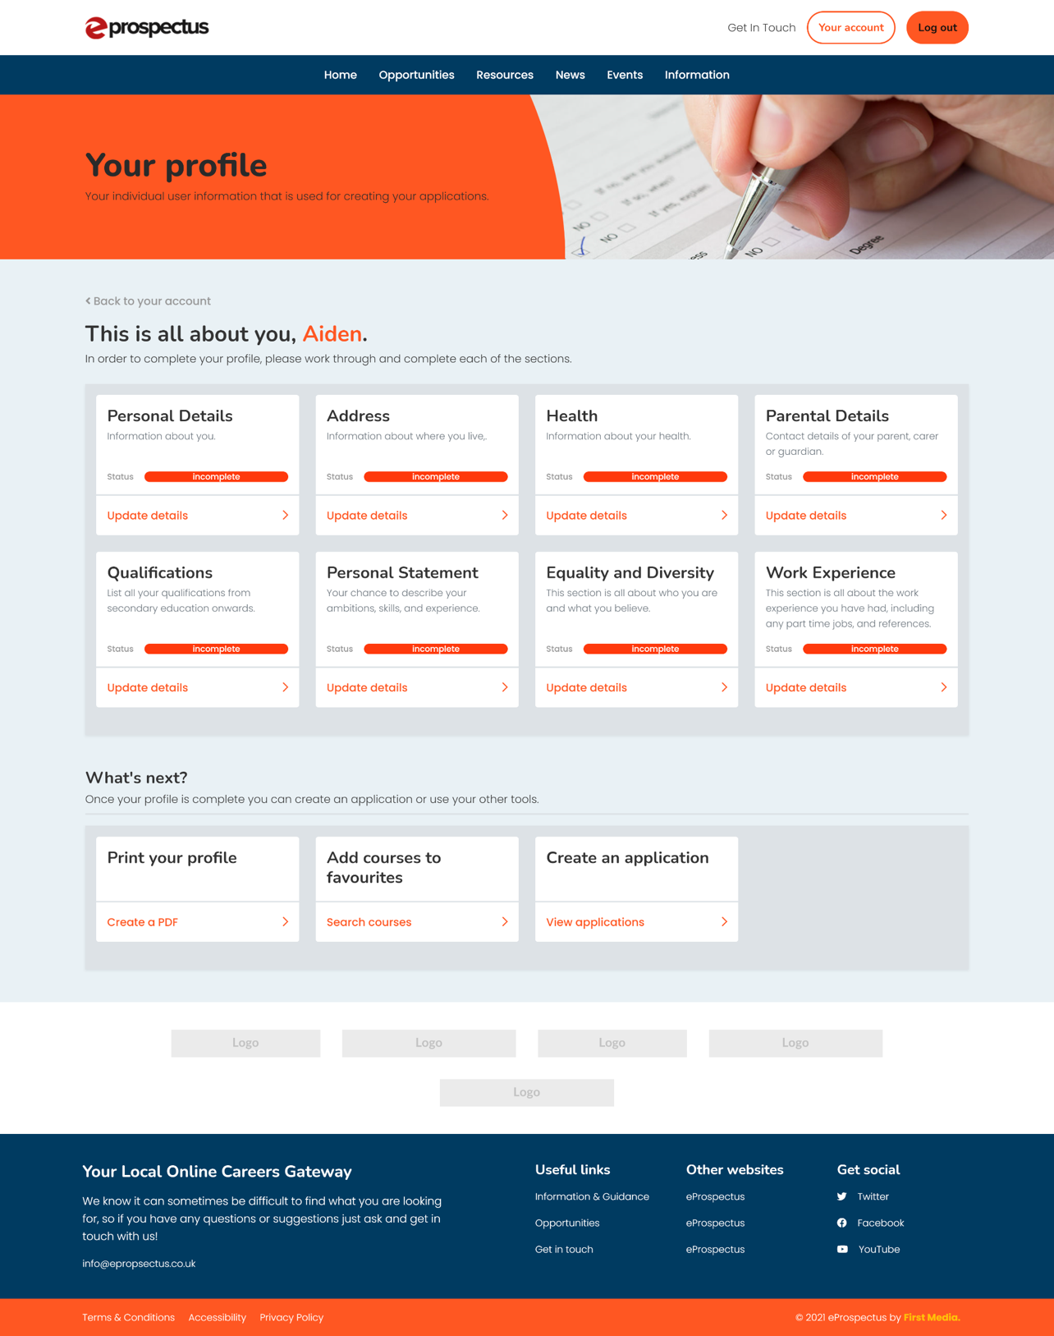
Notes:
Here you can see the sections that make up the profile, you need to work through all of them to finish your profile.
[click] We will start with Personal Details.

Slide 7
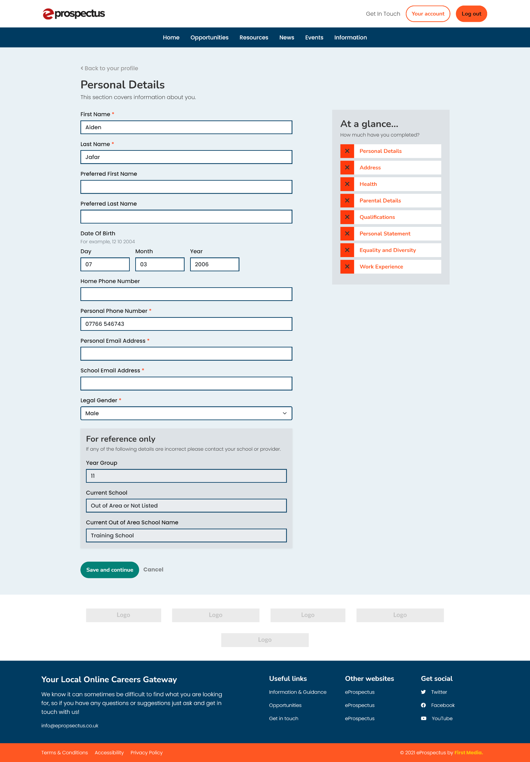
Notes:
You need to review each field and update or add information where necessary.
[click] You need to make sure you add an email address – it is a good idea to add a personal one too so you can receive updates on your applications after you have left school and your school email address ceases. [click]
[click] When you have finished all the fields click the Save and Continue button.

Slide 8
Notes:
You can see the green progress bar which shows the first part is complete.
[click] Now we will look at the Address Information

Slide 9
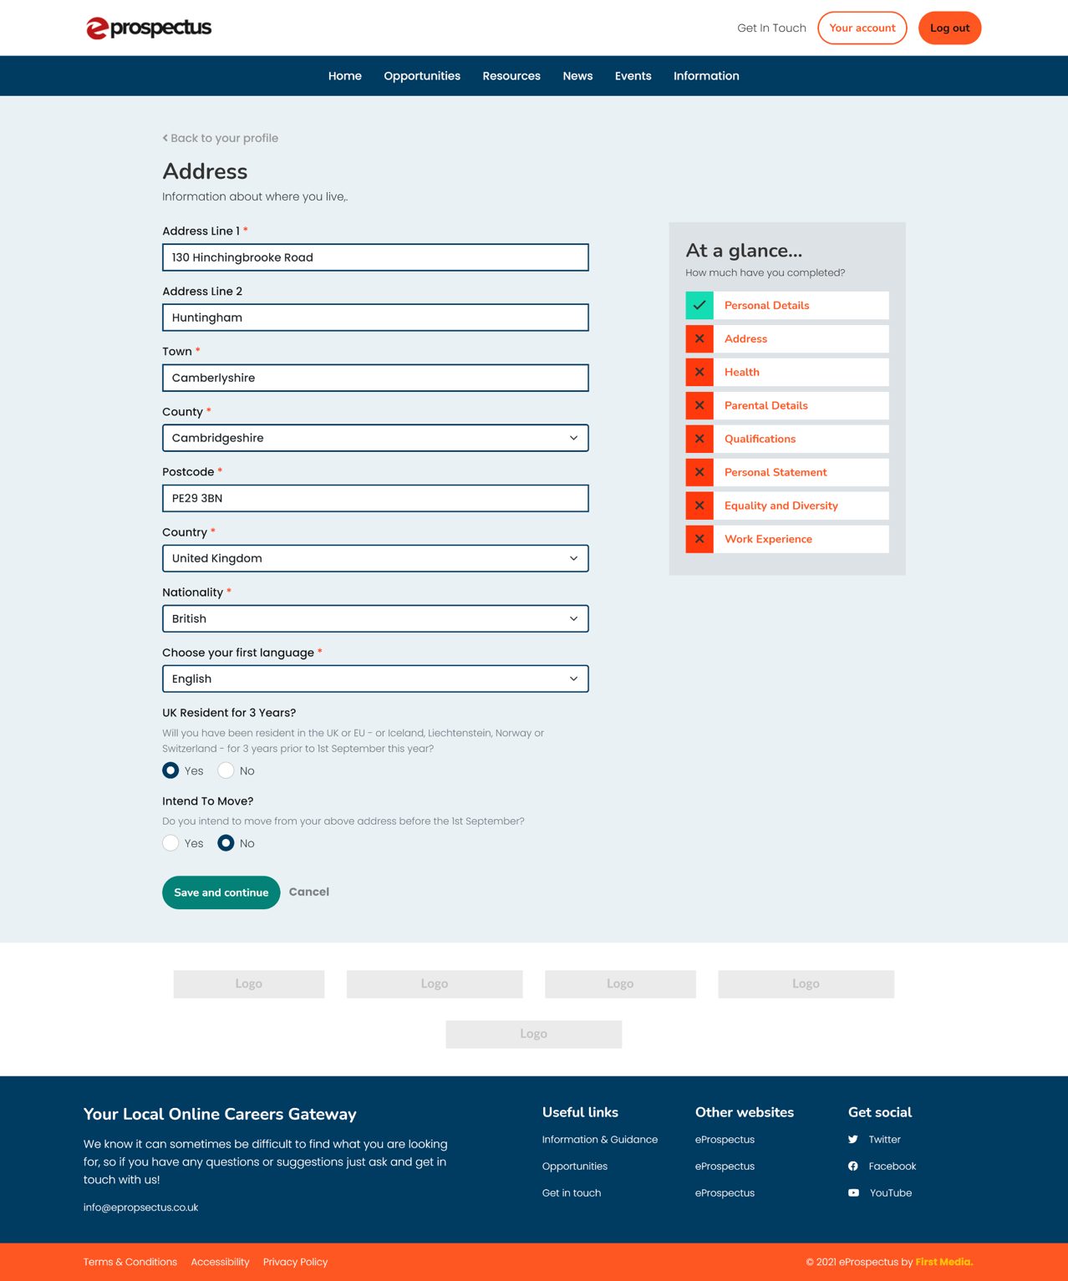
Notes:
Fill in your details [click]
[click] When you have finished all the fields click the Save and Continue button. [click]

Slide 10
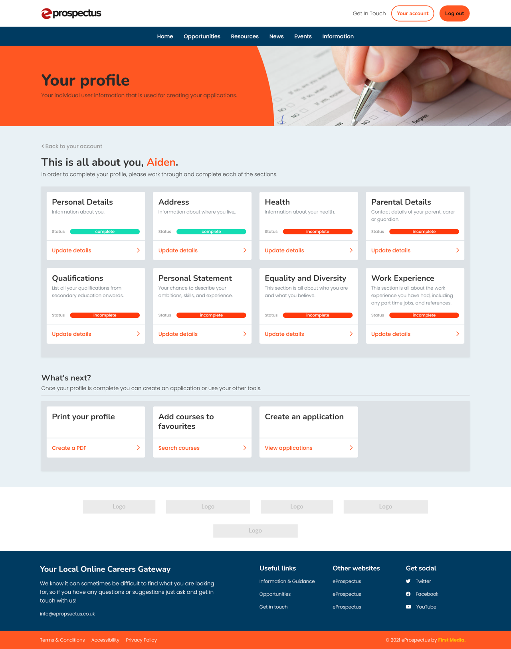
Notes:
[click] Now we will look at the Health Information

Slide 11
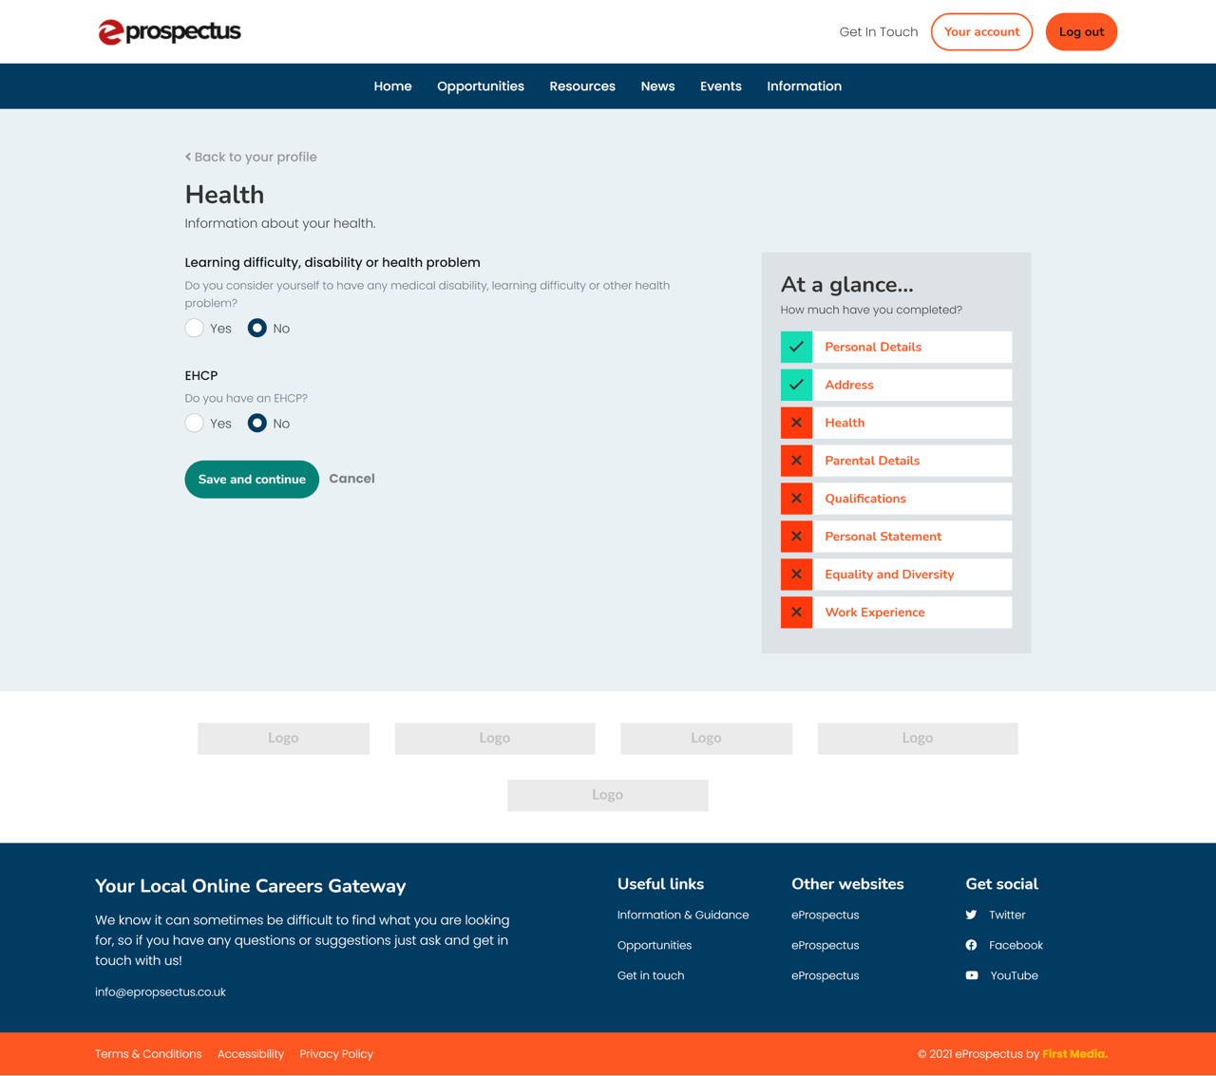
Notes:
Indicate if you have any learning difficulty, disability or health problem and whether you have an EHCP or not.
[click] When you have finished all the fields click the Save and Continue button. [click]

Slide 12
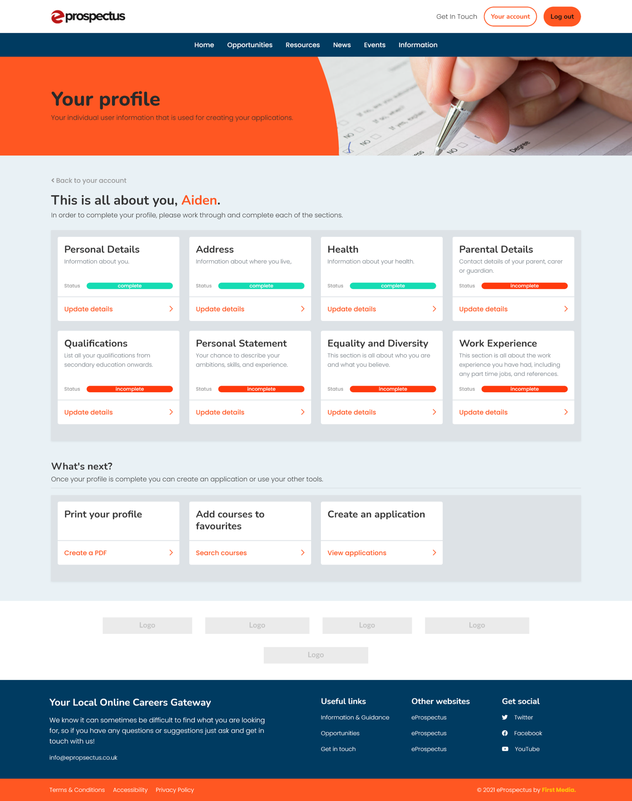
Notes:
[click] Now we will look at the Parental Information

Slide 13
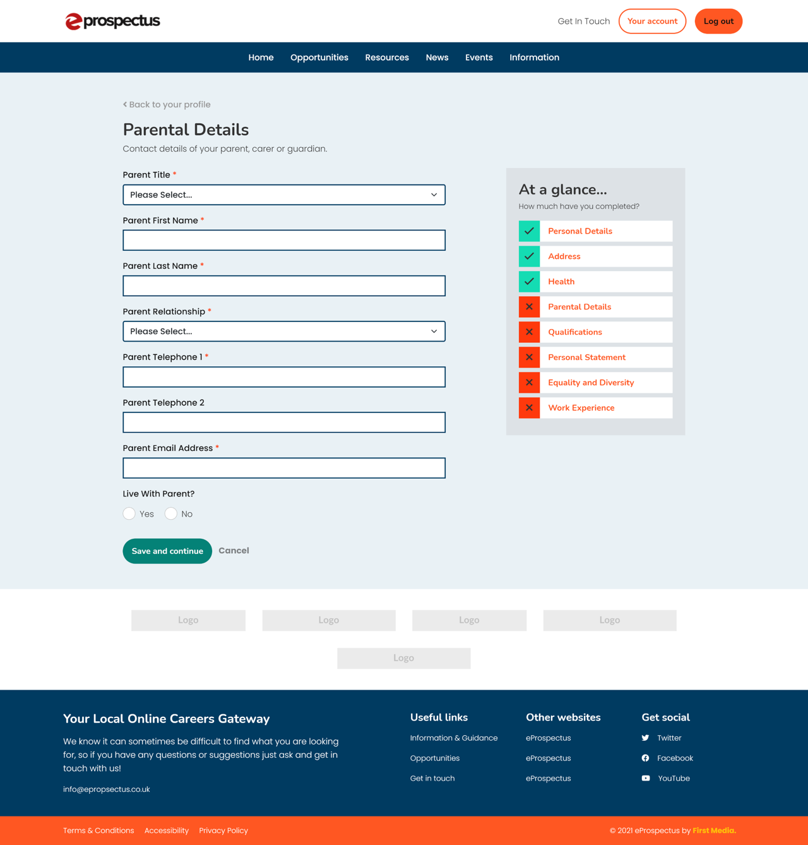
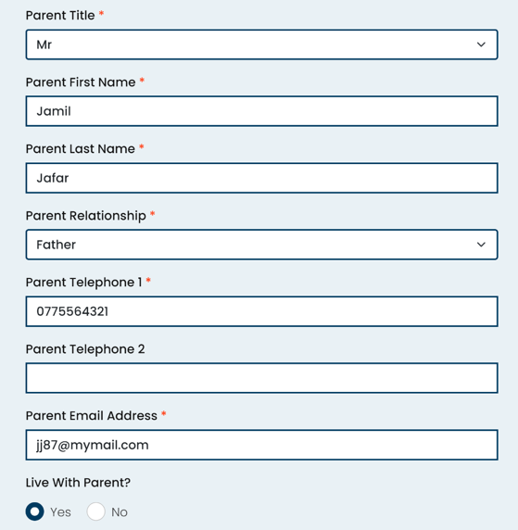
Notes:
[click] Fill in the details [click]

Slide 14
Notes:
[click] Next we have your predicted grades.

Slide 15
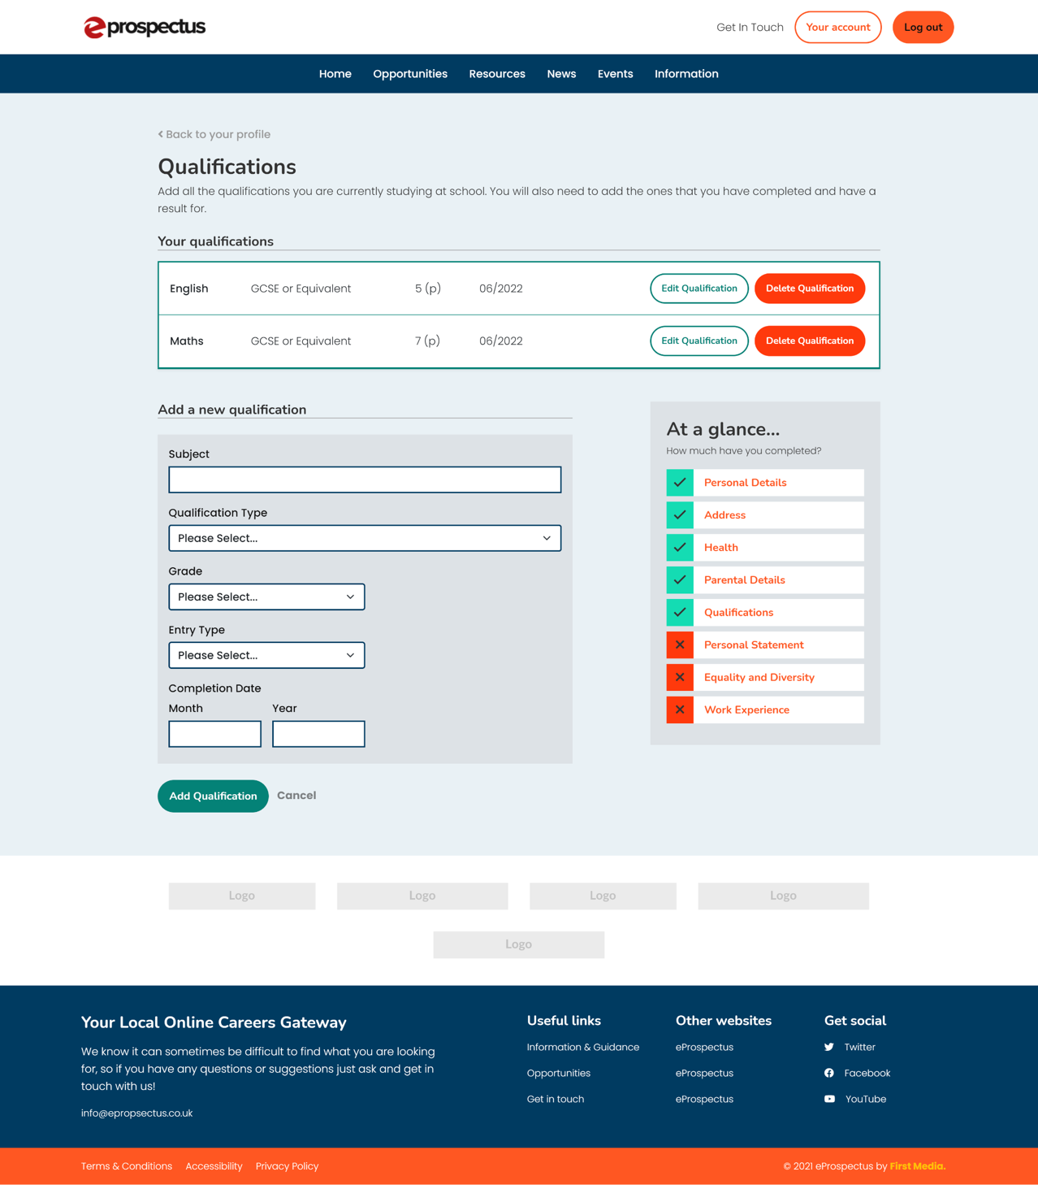
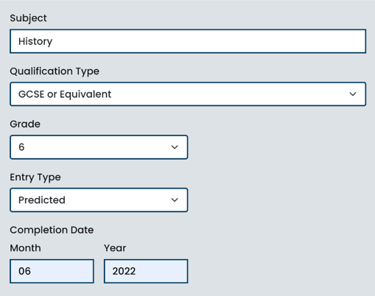
Notes:
[Your grades will have be uploaded by the school- please skip this section]

Slide 16
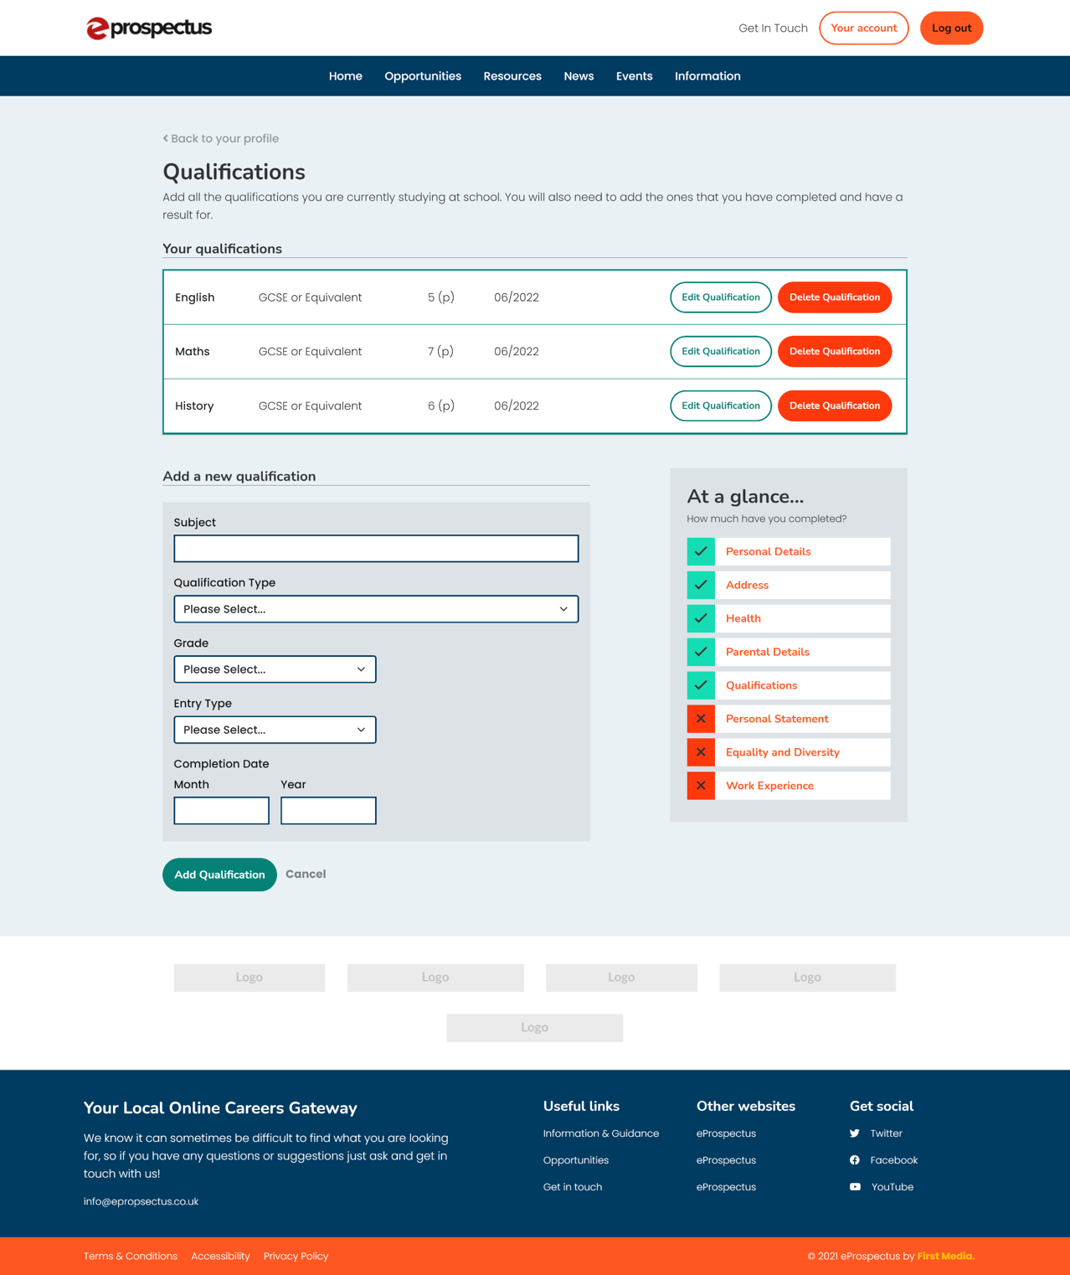
Notes:
You can see it has been added to the list – do this for all your grades.
[click] When you have finished click the back to profile link.

Slide 17
Notes:
[click] Personal Statement is next

Slide 18
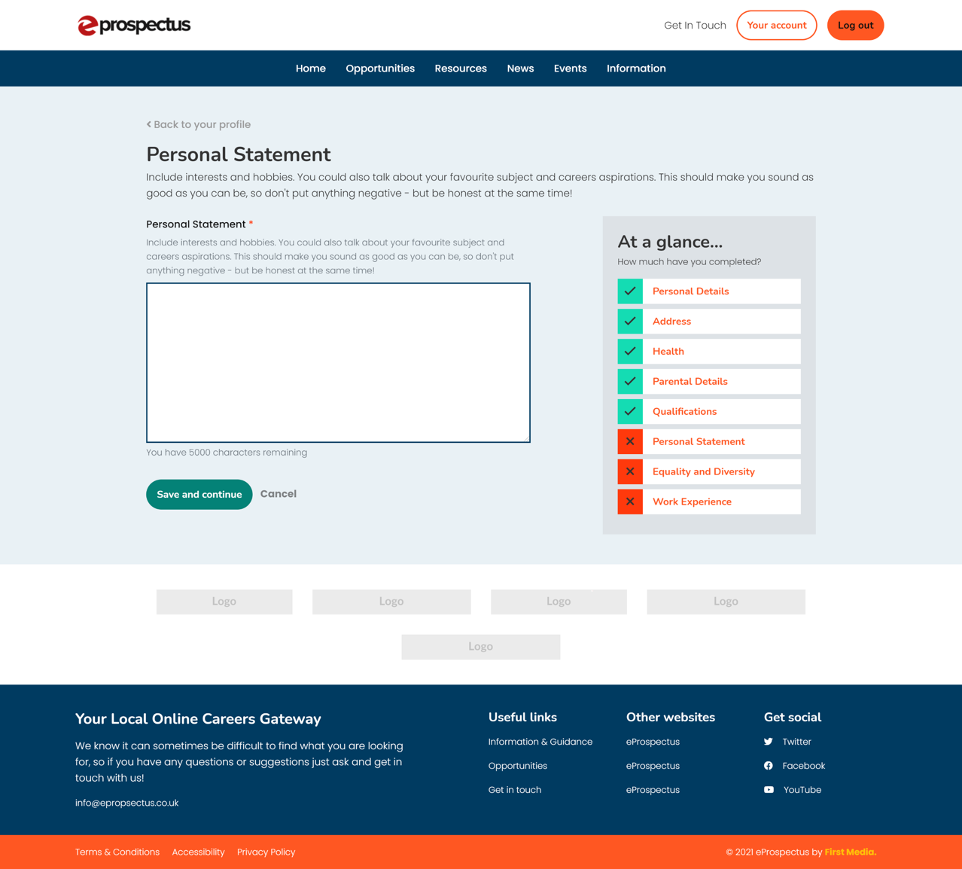
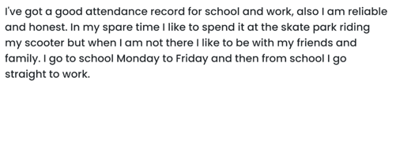
Notes:
Fill in your information or copy and paste from word.
[click] Remember to click the Save button.

Slide 19
Notes:
[click] Now is Equality & Diversity.

Slide 20
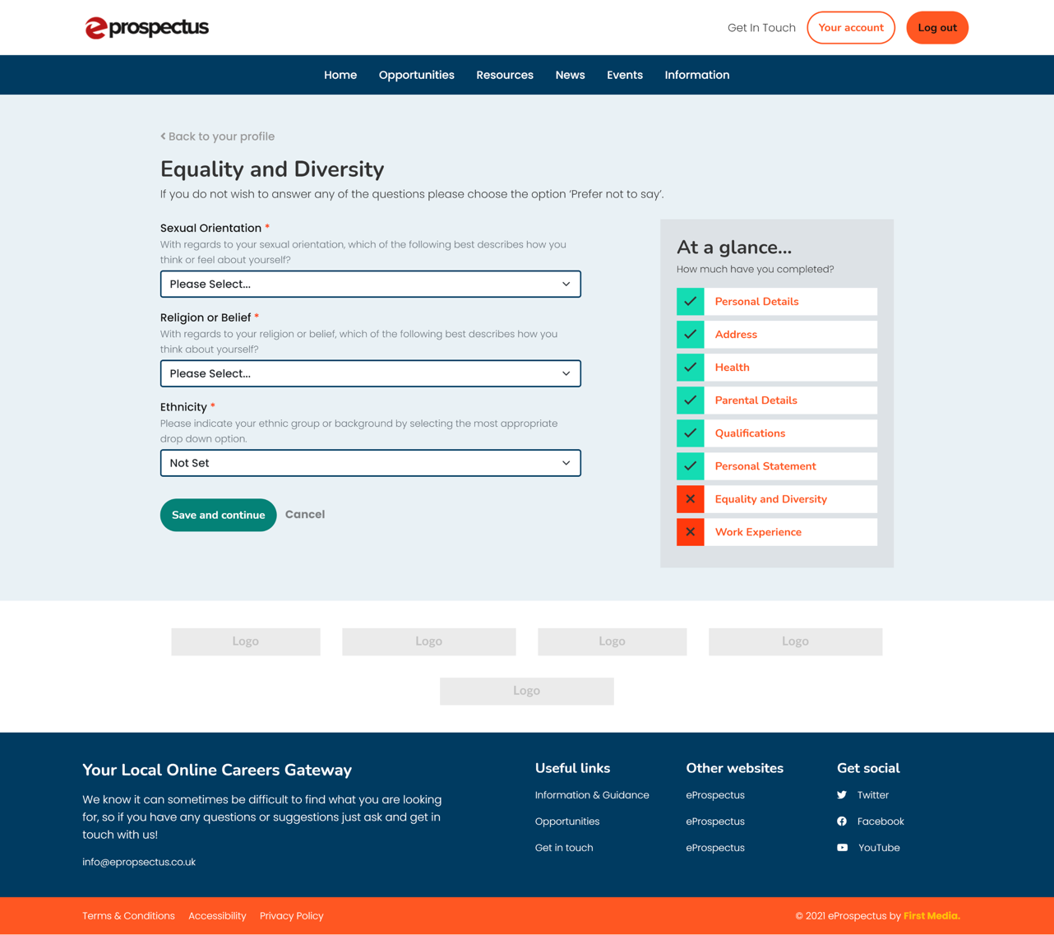
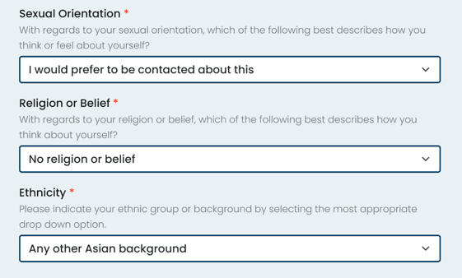
Notes:
[click] Choose the appropriate answer from the drop downs

Slide 21
Notes:
[click] finally we have work experience.

Slide 22
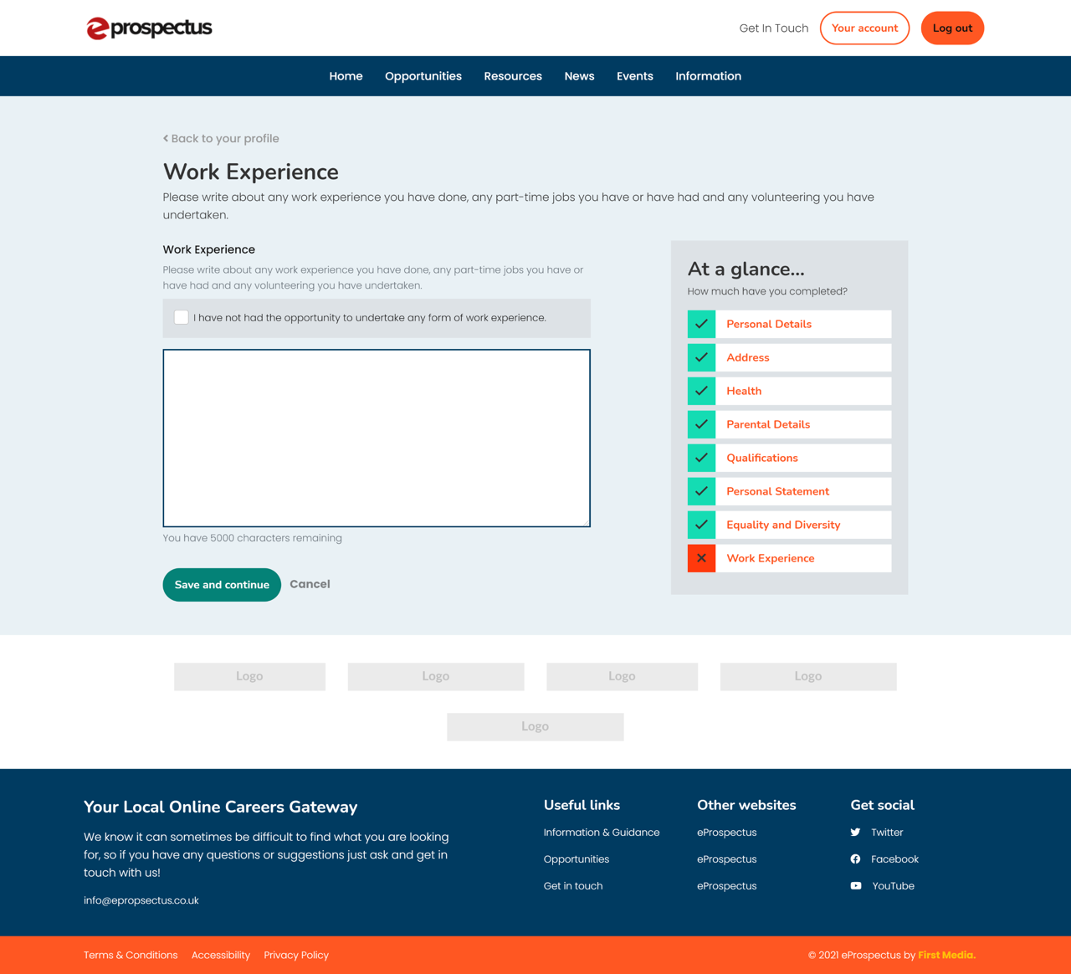
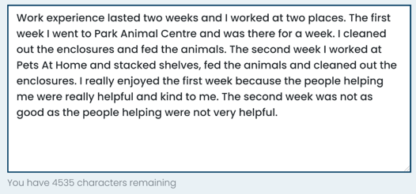
Notes:
Use this section to list any work experience, part time jobs or volunteering.
If you haven’t had any then you can tick the checkbox at the top
[click] Otherwise fill in the information
Then click the Save button.

Slide 23
Notes:
All section are green so our profile is complete. Remember you can do it all in one go or build it up over several weeks.
[click] Next we need to choose some courses to add to our favourites. [click]

Slide 24
Notes:
This goes to the Opportunities section where you can choose from different types of courses.
[click] We are going to look at full time courses

Slide 25
Notes:
[click] Type in the name of the subject or course you are interested in.
[click] Then click the Search button.

Slide 26
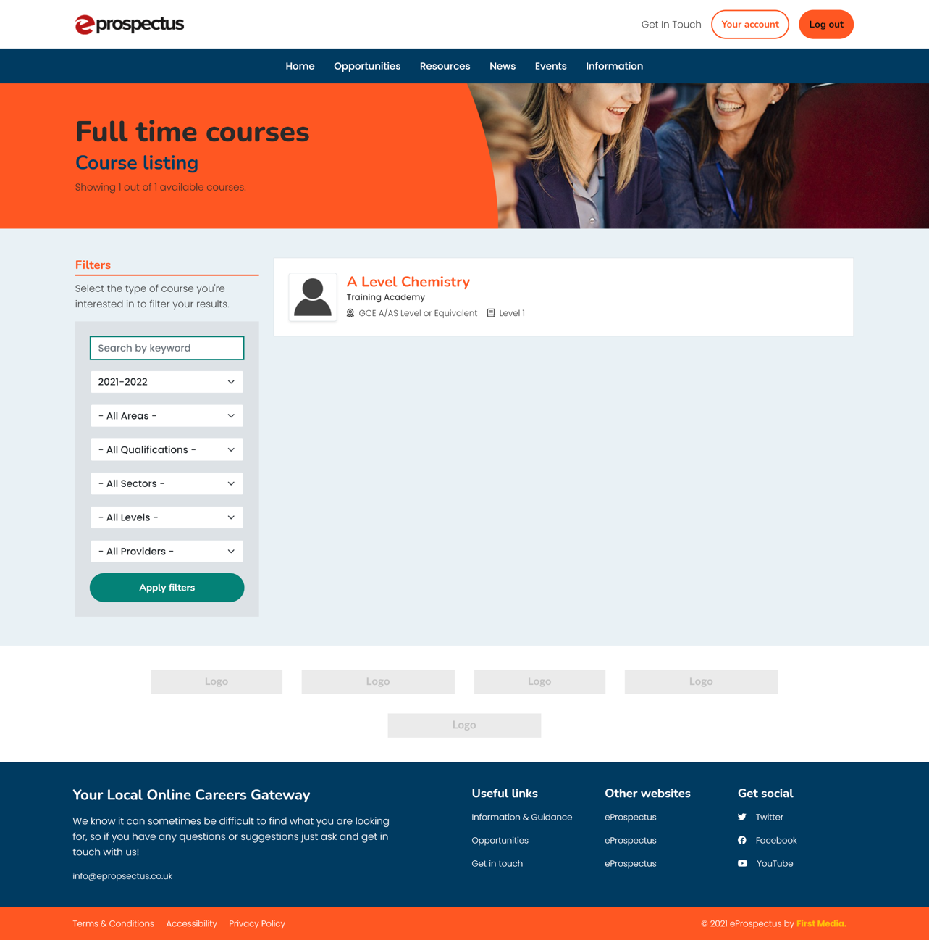
Notes:
The results page shows all the courses matching your search term.
[click] We are going to click on this course.

Slide 27
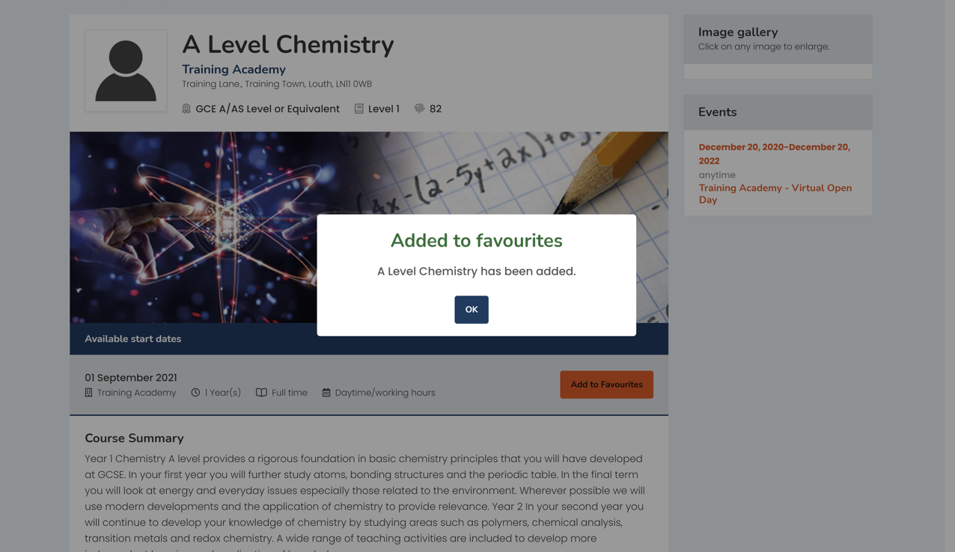
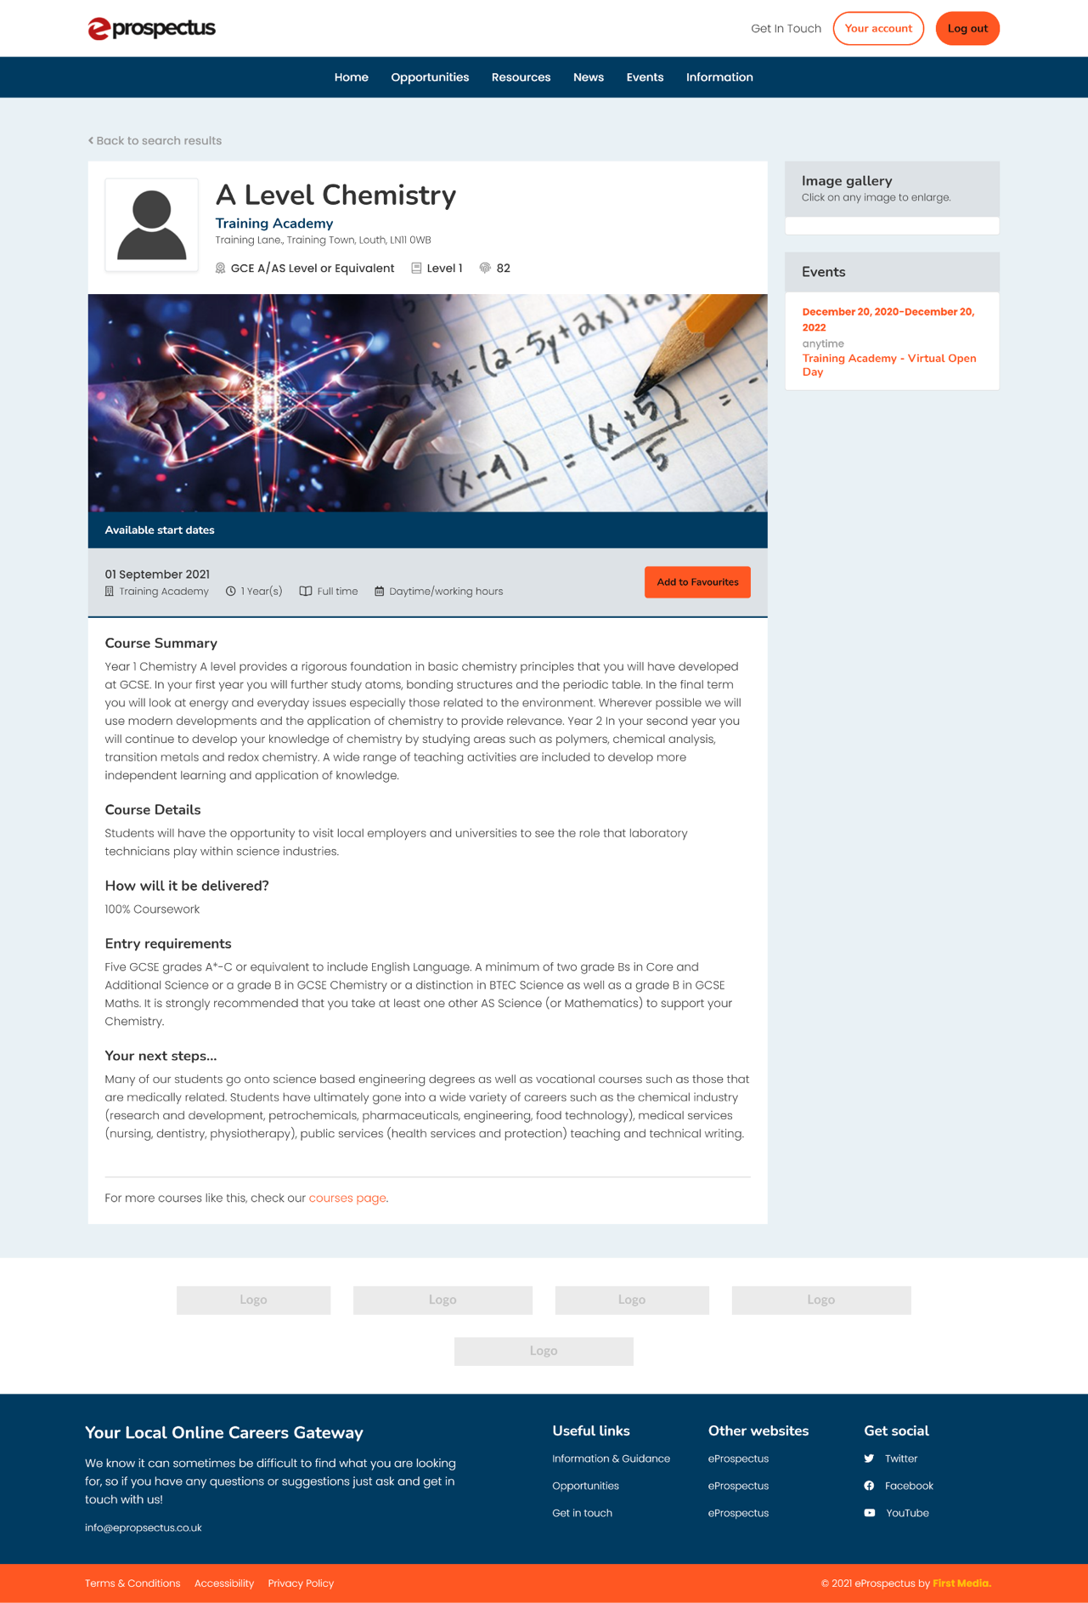
Notes:
This shows the information for the course, if it is what you are looking for then add it to your favourites.
[click] To do this click the Add to Favourites button.
[click] A confirmation pops up
[click] Click OK to close it. [click]

Slide 28
Notes:
You should do this for all the courses you are interested in.
[click] Now we are going to go back to our account page.

Slide 29
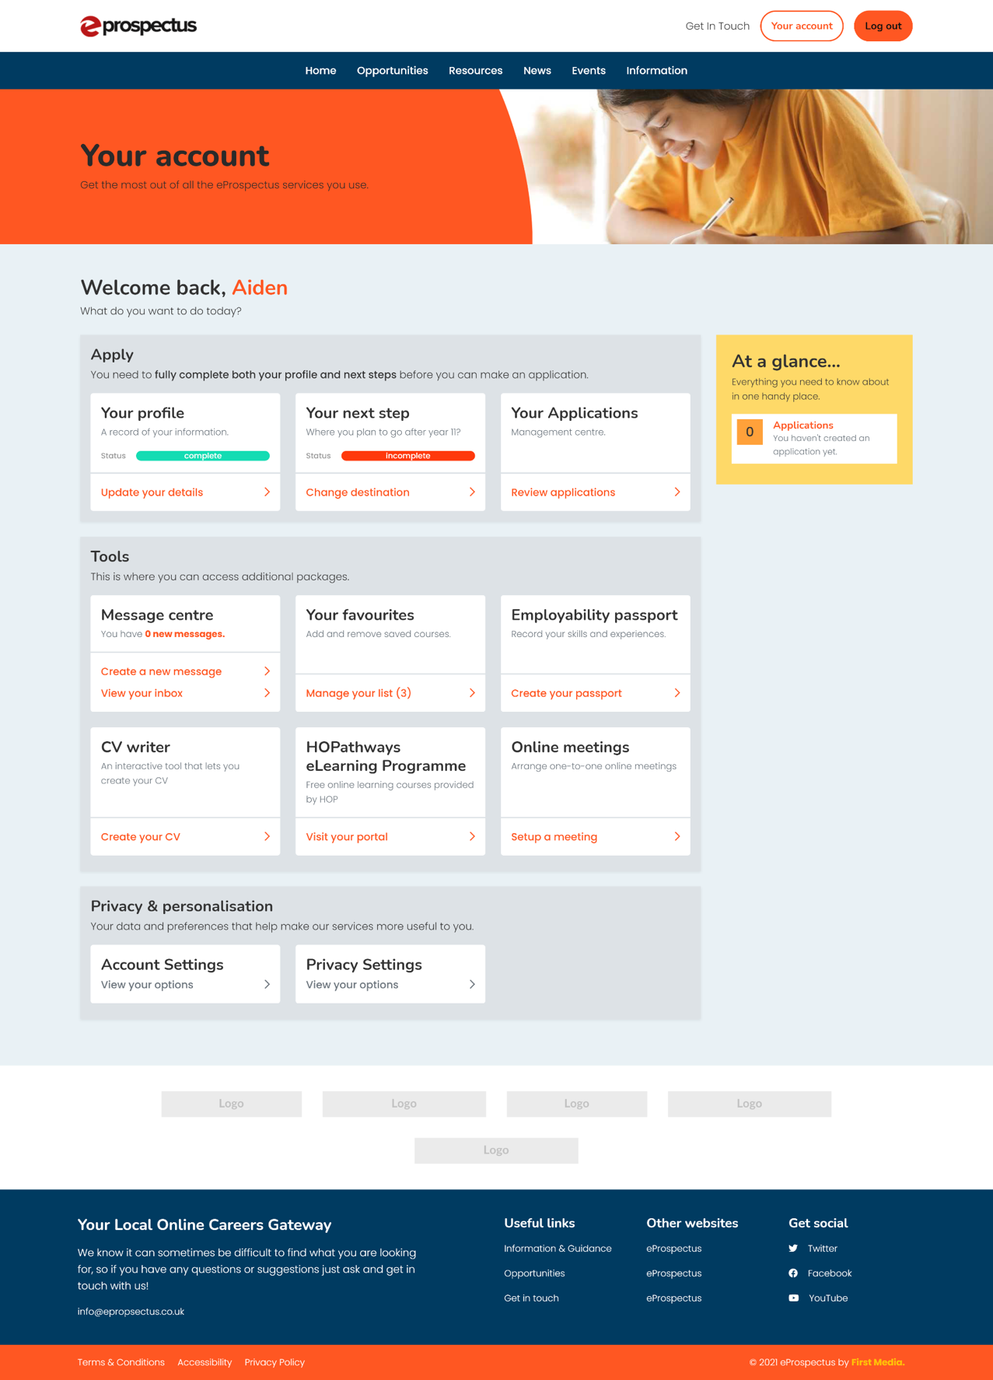
Notes:
[click] Now lets make an application, click the Applications button.

Slide 30
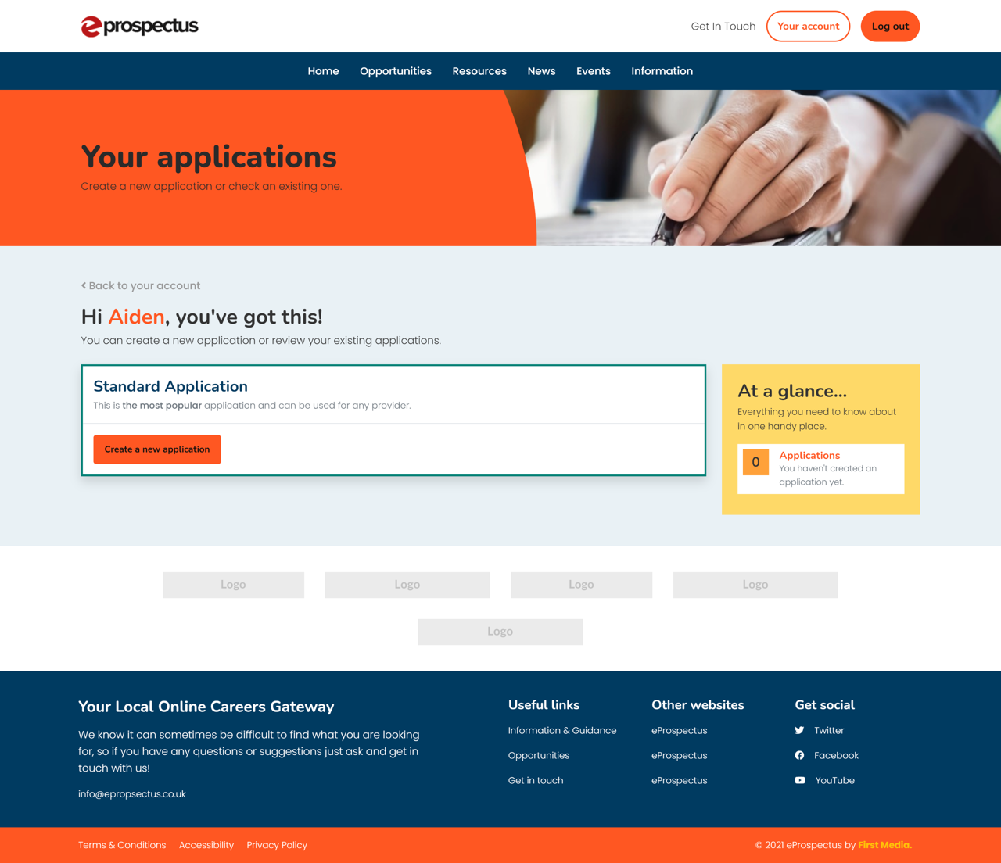
Notes:
[click] click the Create a New Application button.

Slide 31
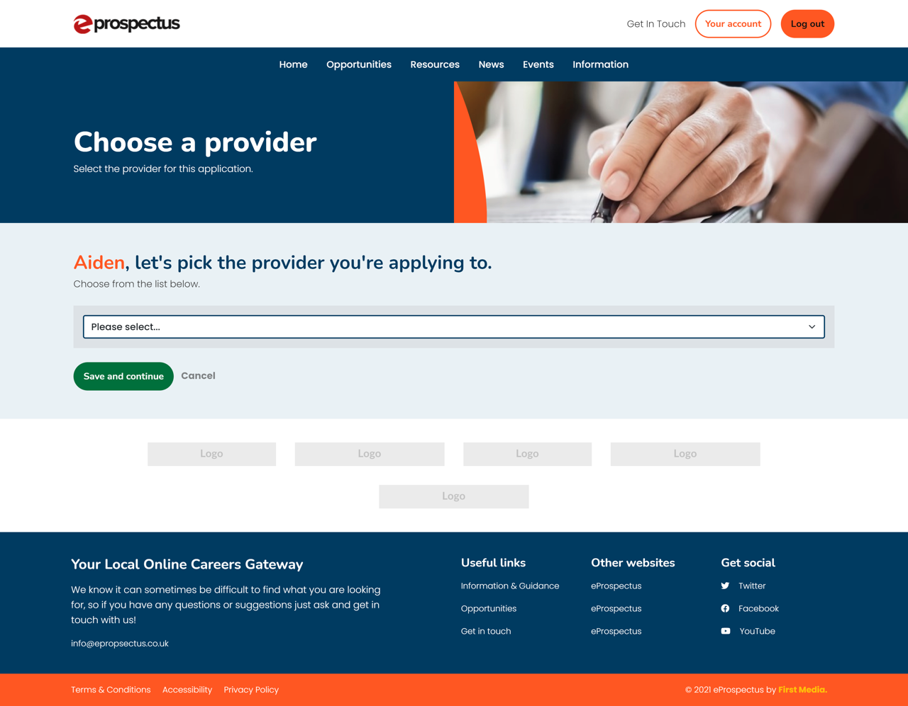
Notes:
We need to choose which provider the application will be for [click]
[click] then click Save and Continue

Slide 32
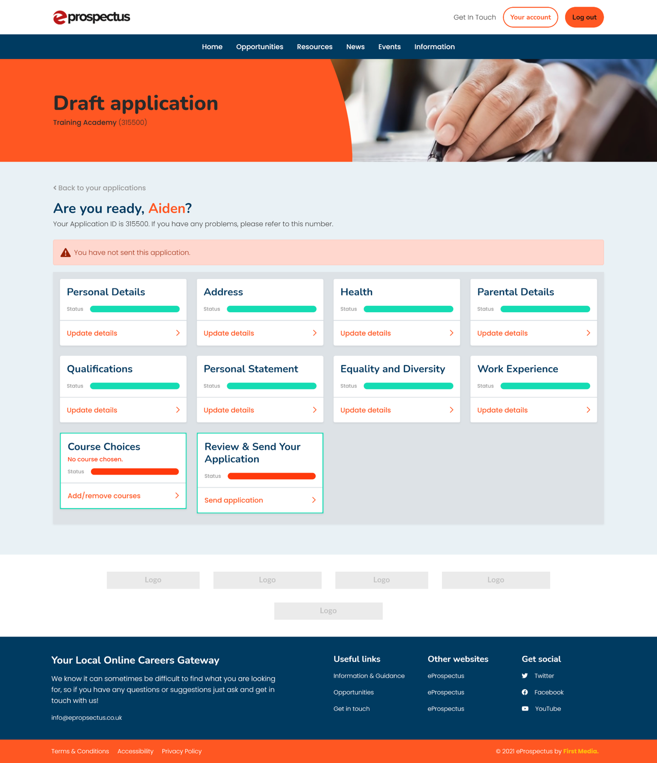
Notes:
You can see it has copied our profile to this application.
[click] We need to add our course choices.

Slide 33
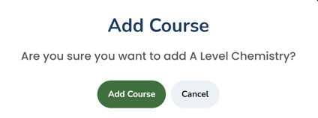
Notes:
You can see our favourites listed.
[click] We are going to add the first one to our application.
[click] Click the Add Course button
[click] Click the confirmation

Slide 34
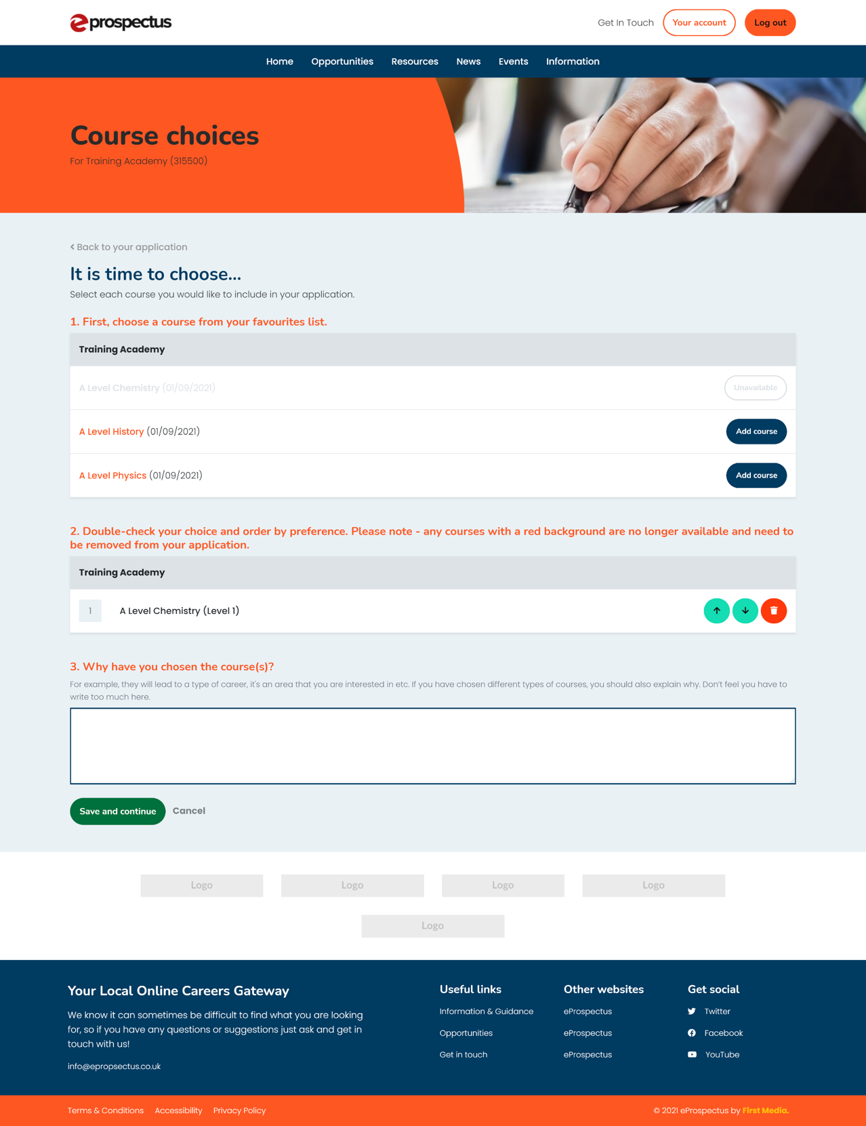
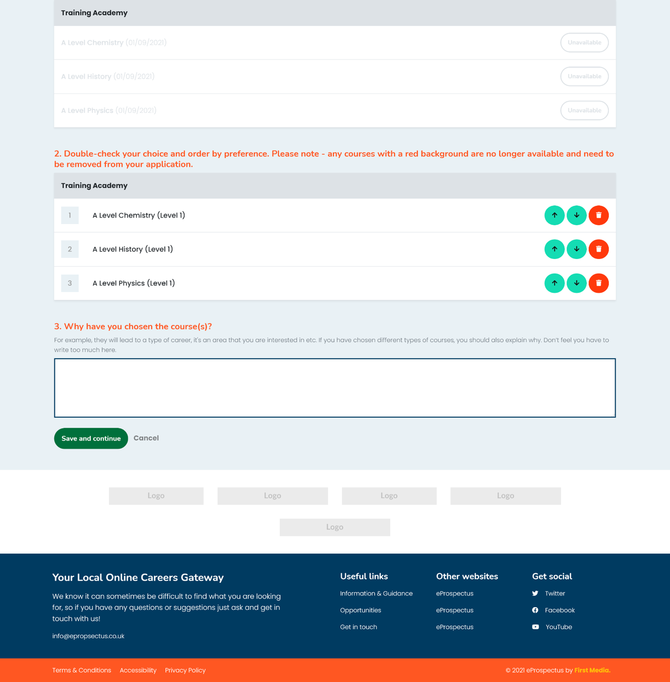
Notes:
You can see it has added the course
[click] Now add the other two in the same way
[click] We now have all three added
[click] We want to show that History is our first preference
[click] So we click the up arrow on this line
[click] History is now at number 1

Slide 35
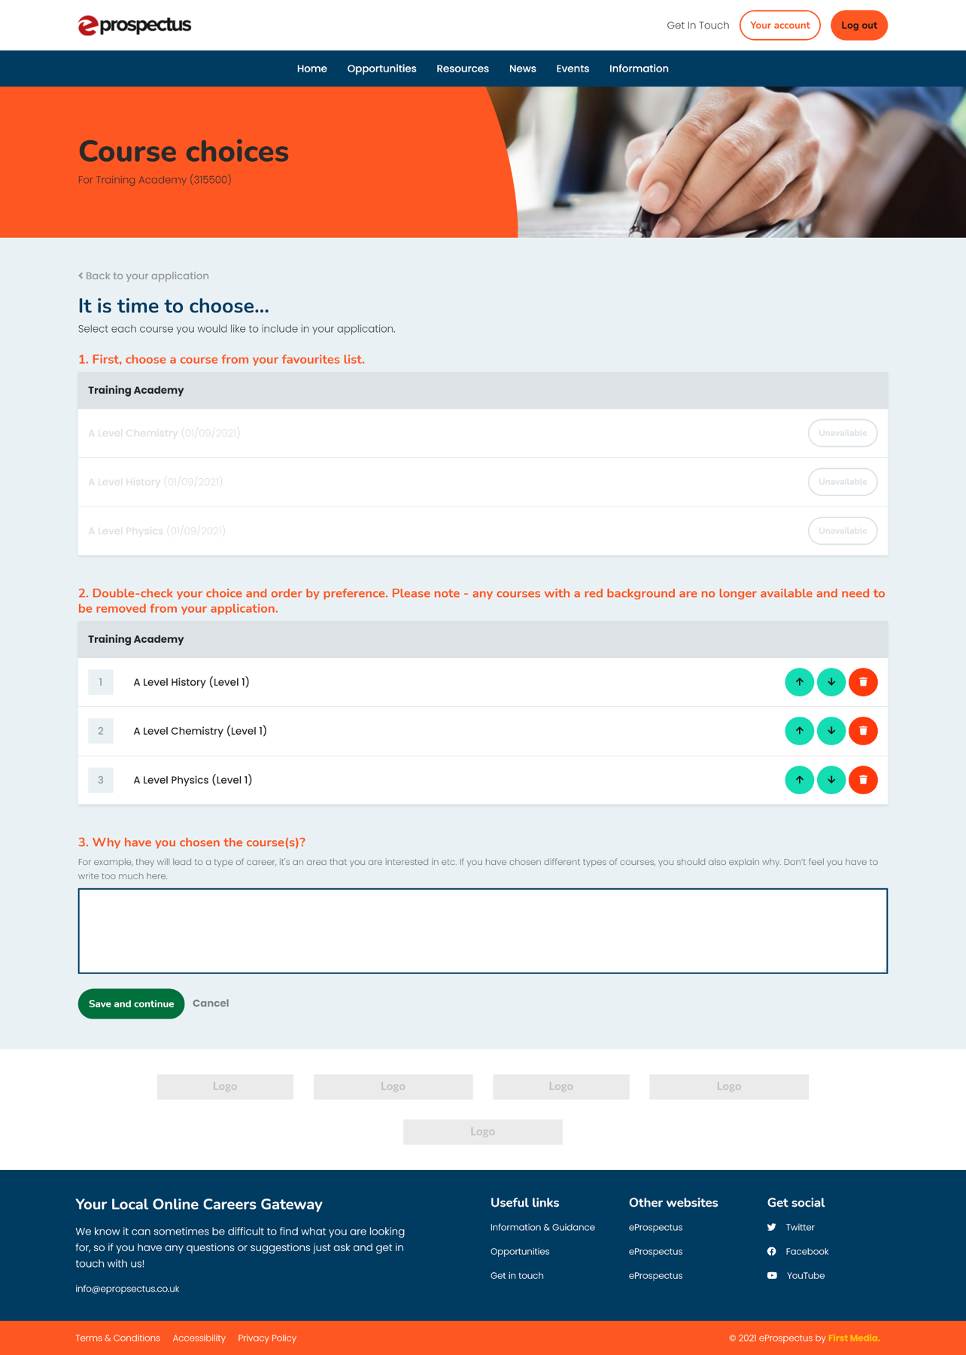
Notes:
[click] Next we need to enter some text about why you want to do these courses or study with this provider.
[click] Add your text
[click] Then click the Save and Continue button.

Slide 36
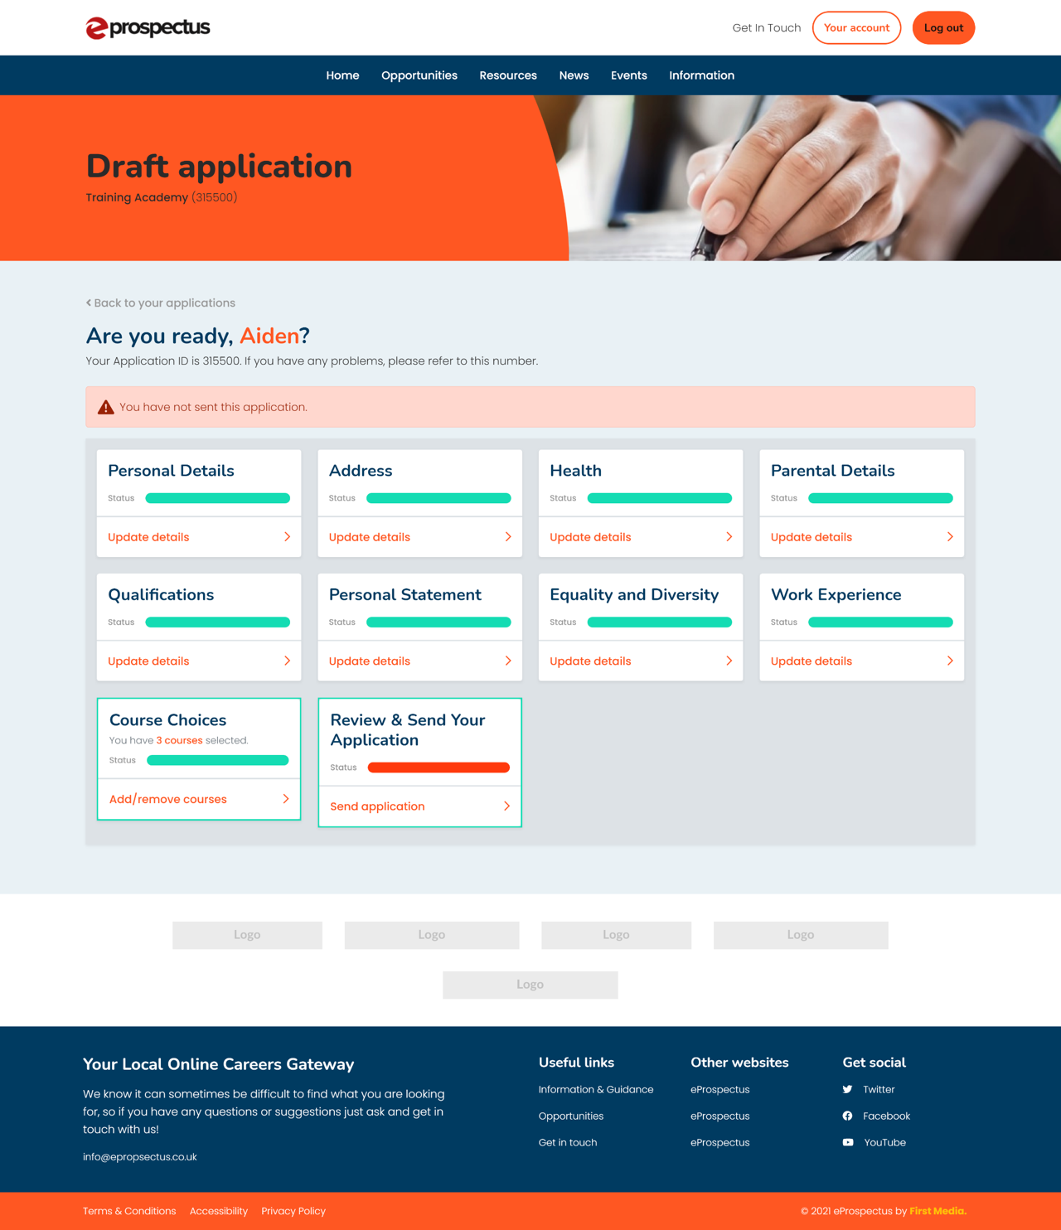
Notes:
[click] Just one step left

Slide 37
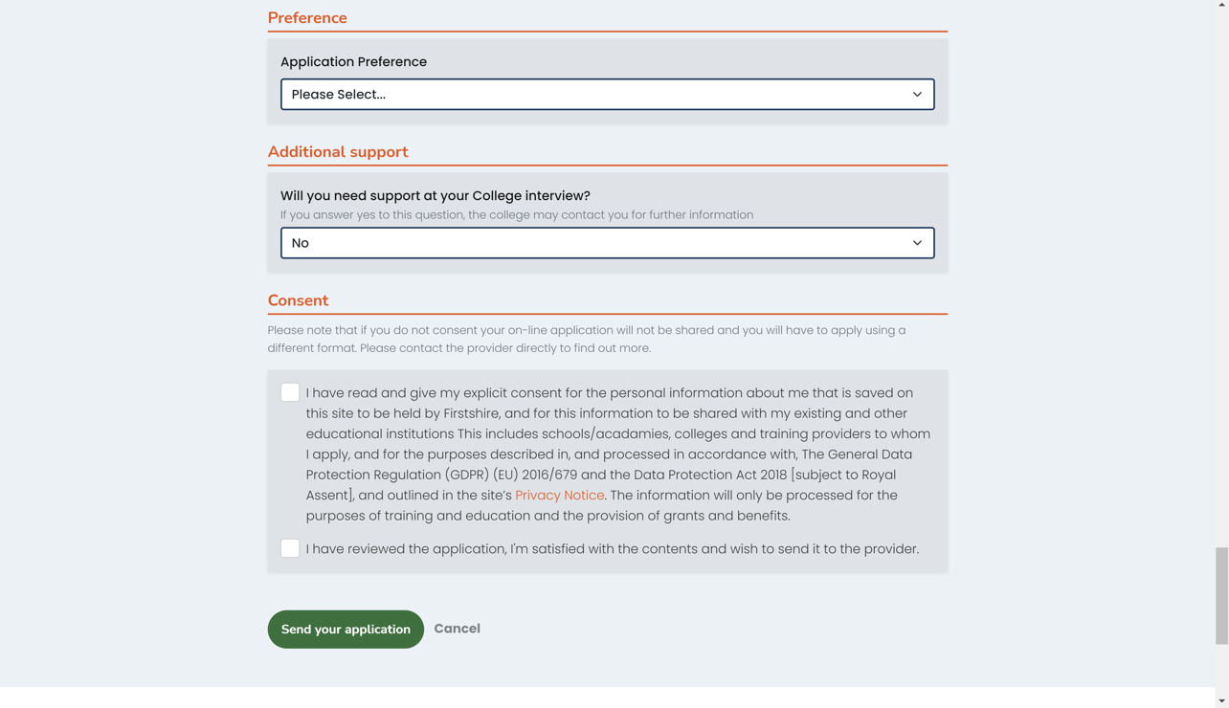
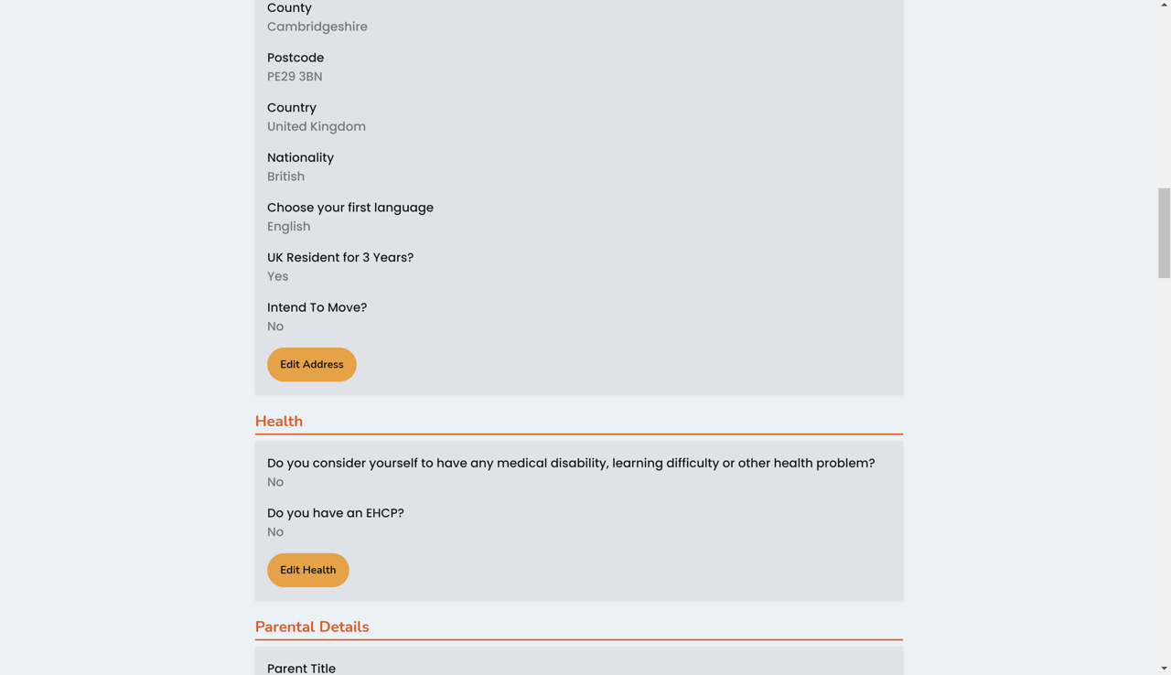
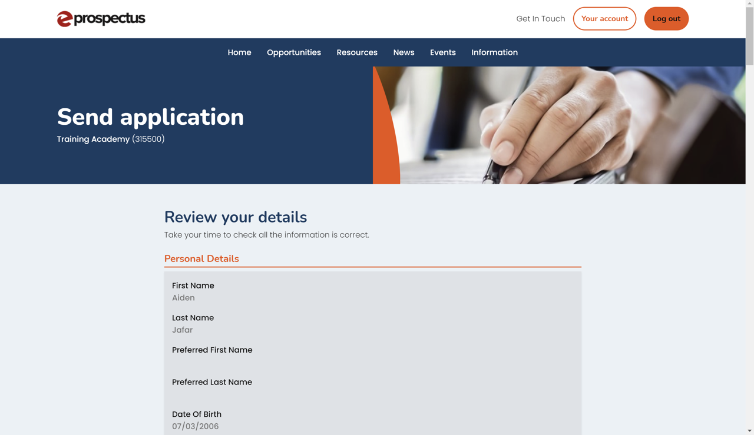
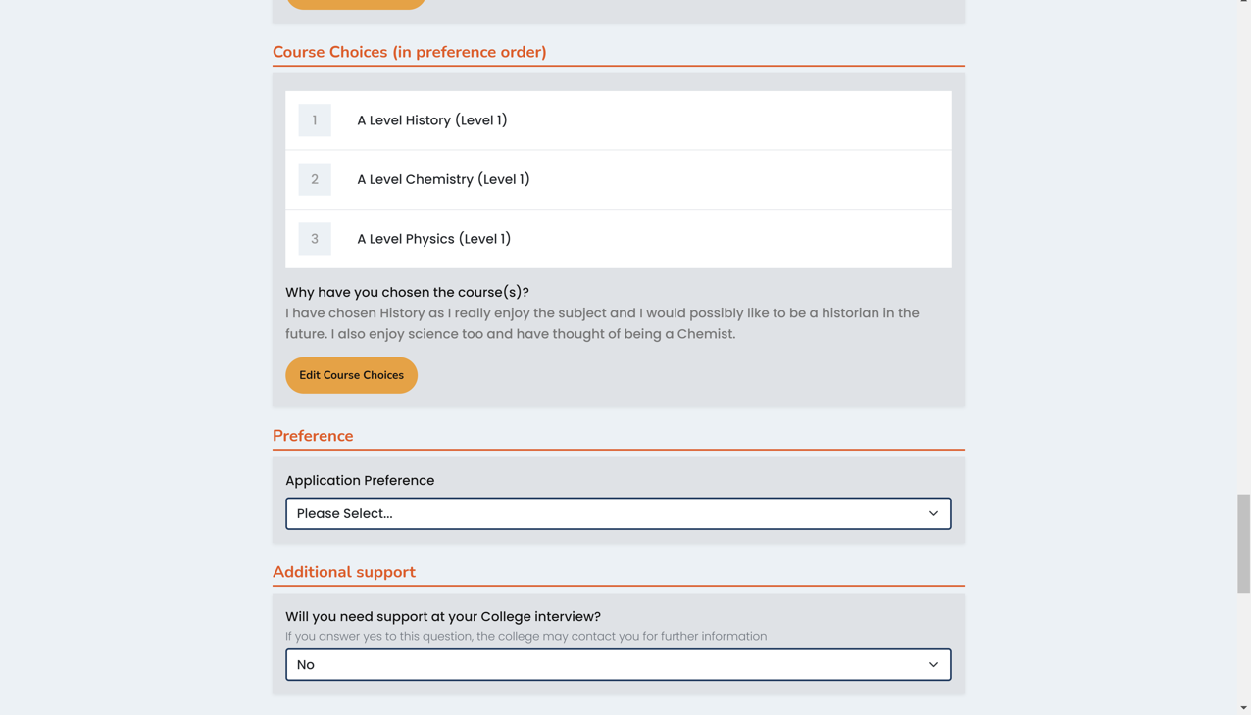
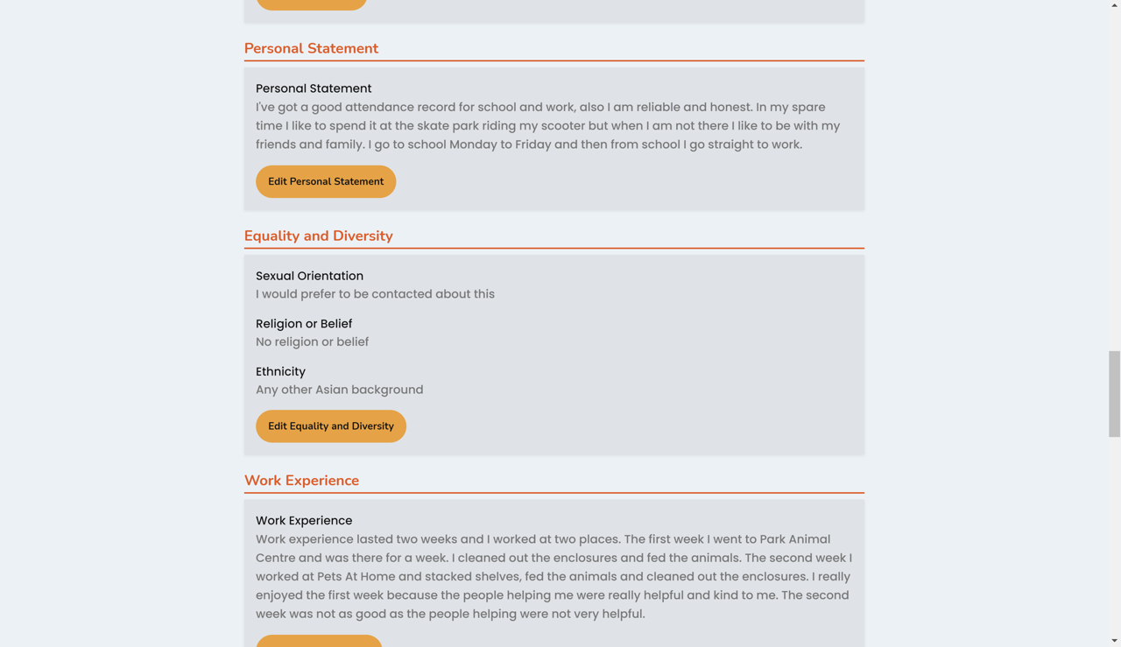
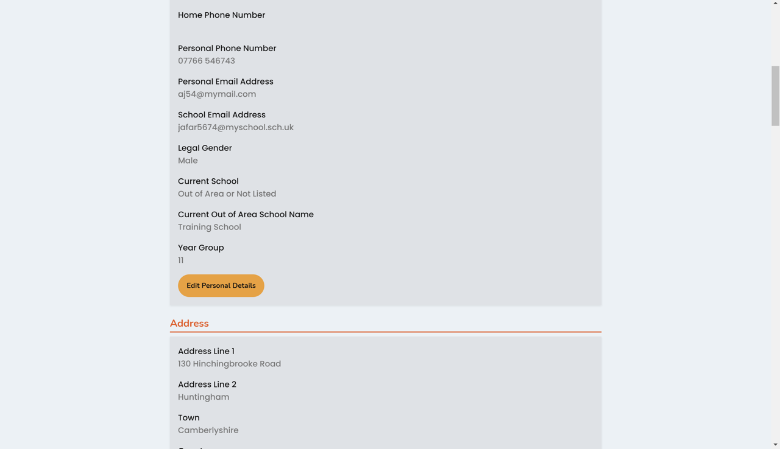
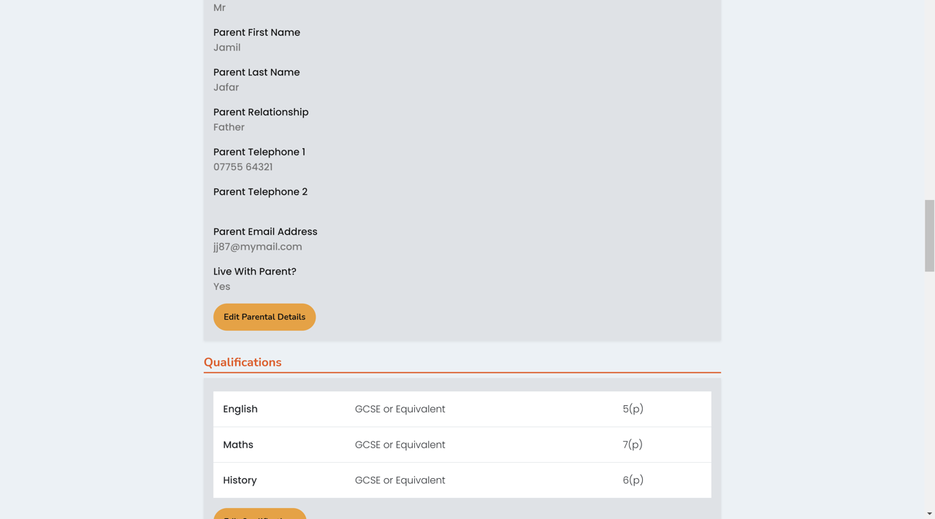
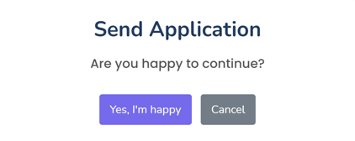
Notes:
This page allows you to review your whole application. Work your way down and use the links in each section if you want to make any changes.
[click] Otherwise scroll to the bottom and answer the questions
[click] Firstly choose the preference for this application
[click] We will choose first on this occasion
If you need any help at your meeting with the provider select yes from the list.
[click] Finally you need to confirm you are happy for your data to be shared with the provider.
[click] Click the send button [click]
[click] Then confirm you are happy to continue

Slide 38
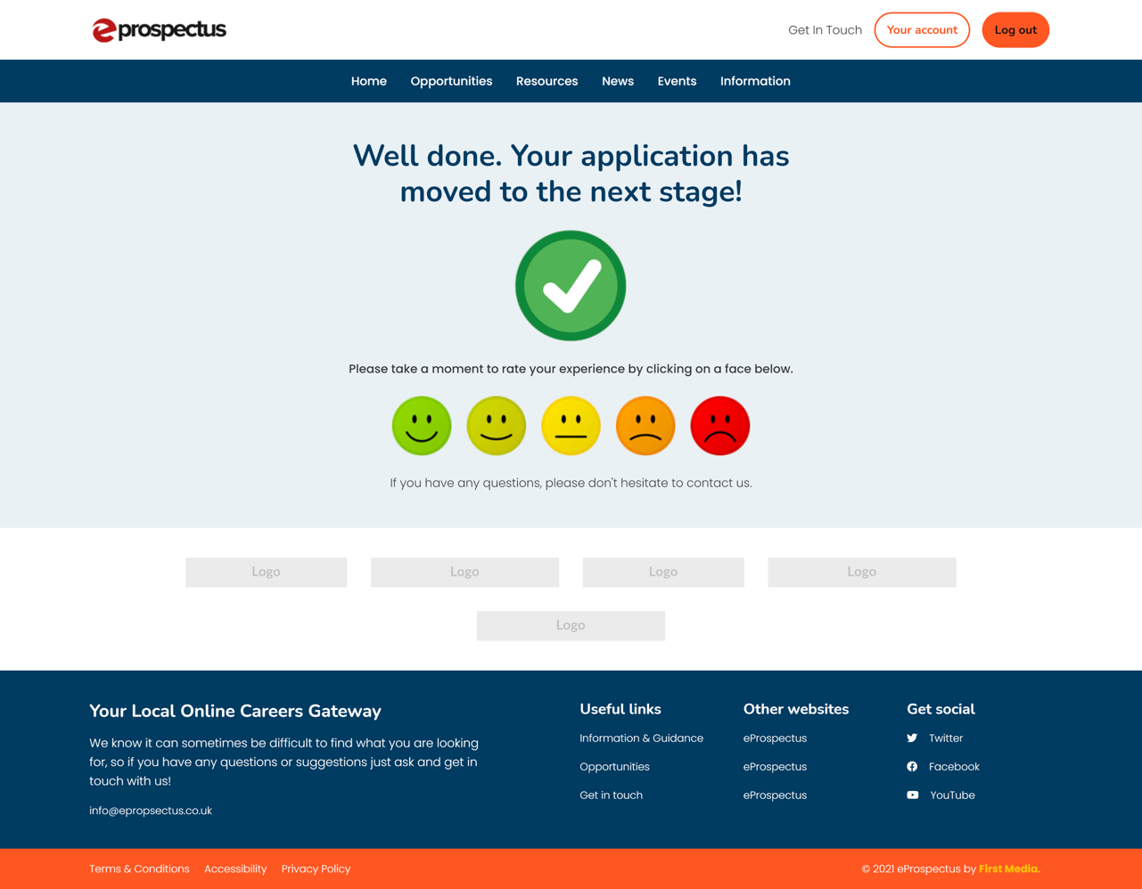
Notes:
All done.
Click on a Smiley face to rate your experience

Slide 39
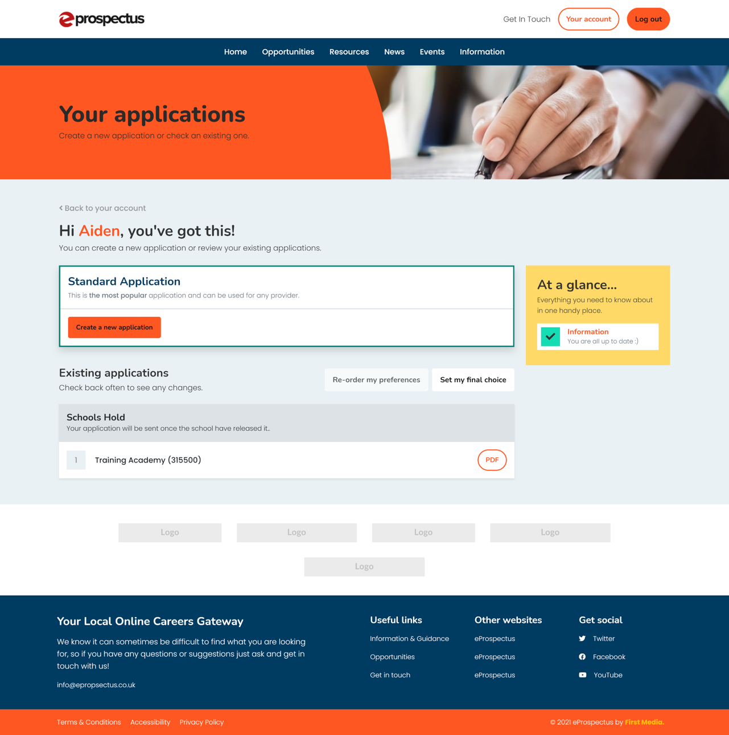
Notes:
No Reference version
[click] Your account page shows the status of your application. You will get an email notification when your application status changes and you can return here to see it.

Slide 40
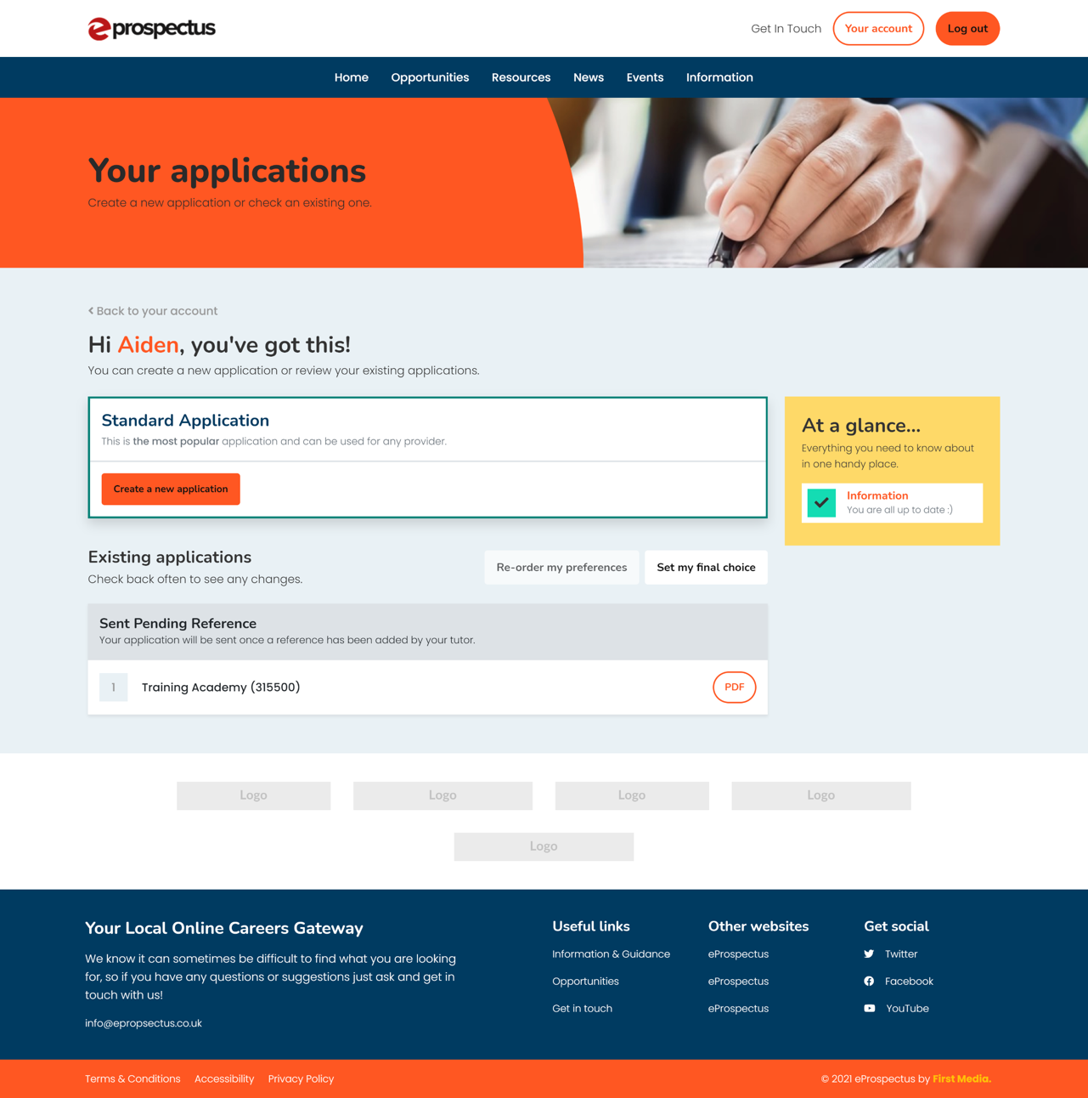
Notes:
[click] Your account page shows the status of your application. You will get an email notification when your application status changes and you can return here to see it.

Slide 41
How to Search & Apply
Guide for Learners v2.0

