Slide 1
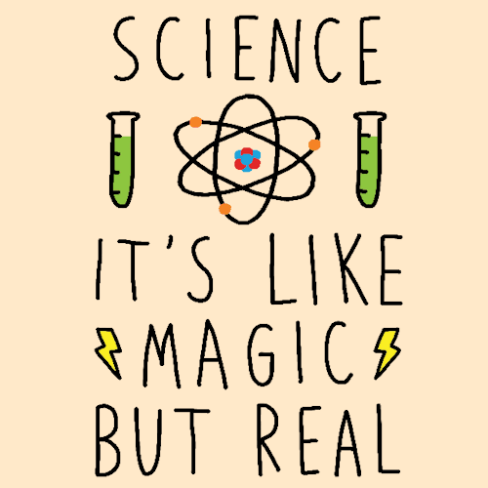
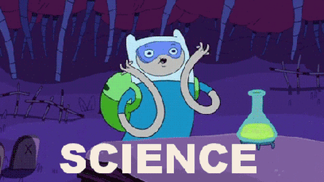
Welcome to Science at Cambourne Village College

Slide 2
Activities for today
Draw and explain your ideas about what a scientist is and does.
Look at different ideas about what a scientist is, and who can be a scientist
Finding out about (researching) famous scientists

Slide 3
Section 1: Take a piece of paper and draw what a scientist looks like. You may choose to colour in your drawing.

Slide 4
Think about your drawing (think about your answers – you don’t need to write them down)
Have you drawn a female or male?
What does your scientist look like, why?
What is your scientist wearing?
Where is your scientist?
Does your scientist look like you?
Is your scientist old or young?
What is your scientist doing in your drawing?

Slide 5
Now draw a picture of yourself doing science in school

Slide 6
Compare your two drawings (think about your answers – you don’t need to write them down)
What is the same?
What is different?
When we do science in school, are we being scientists?

Slide 7
Section 2
Now we will have a look at different scientists.
Look at the next slide and see if you recognise any of the scientists’ names on the list.
Then move onto slide 9 for your next activity

Slide 8
Famous Scientists
1. Tiera Guinn 2. Isaac Newton 3. Mae C Jemison 4. Charles Darwin 5. Ellen Ochoa 6. Ada Lovelace 7. Charles Drew ​ 8. Rosalind Franklin 9. Florence Nightingale 10. Philip Emeagwali 11. Dmitri Mendeleev 12. Hypatia 13. Erwin Schrödinger 14. Nikola Tesla 15. Carlos Juan Finlay 16. Louis Pasteur
17. Archimedes of Syracuse 18. Jane Goodall 19. Jennifer Doudna 20. Katherine Freese 21. Marie Curie 22. Sara Seager 23. Benjamin Banneker ​ 24. Ḥasan Ibn al-Haytham 25. Ernest Everett 26. Alan Turing 27. Jagadish Chandra Bose 28. Subrahmanyan Chandrasekhar 29. Yuri Oganessian 30. Hiroshi Amano 31. Tycho Brahe 32. Mary Anning

Slide 9
Researching Famous Scientists
Choose two scientists from the previous slide (1 male and 1 female) and find out about them.
Look at the next slide for more details on what to find out about them.
Once you have found out the information, display it on a poster. (You can draw them on paper or on the computer).

Slide 10
Everyone should find out the following:
Birth date and Year of Death if not alive. If your scientist is still alive, how old they are now
In what country was this person born and where did they do their work?
One sentence explaining why your scientist is famous or a catch phrase
An interesting fact
A sentence summarizing your scientist’s accomplishments, in your own words.
A picture of what they worked on or what they discovered.

Slide 11
Some of you may also wish to find out the following:
A sentence summarizing your scientist’s accomplishments, in your own words.
A picture of what they worked on or what they discovered.
You must choose an additional 3 of the following options to include on your poster
A quote by your scientist.
Educational background of the scientist (not the science field). What college(s) did they graduate from?
Any additional jobs held by the scientist outside the science field.
List 3 events that happened in history when this scientist became famous. Events should include specific wars, top movie for the year, top song for the year or other discoveries.
The name(s) of other scientists that your scientist worked with.
Has anything been named after your scientist? If so, include the city and country

