Slide 1

To do:
Get out your
Class book/paper you are working on. You must keep your notes.
Pen/pencil and ruler
Make sure your volume is on.
2) Watch the video and pause when you need to complete activities. You will see this icon when you need to pause. You should resume the video once you have completed the task.
3) This icon will help point you to some of the answers your are looking for- remember to try your best!
4) Re-watch the video if you need to go over anything again. Email Miss Angell/Mr Green for further help.
Pause!

Slide 2
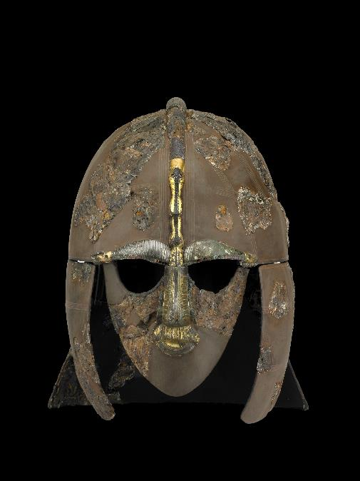
Just as World War Two was about to start in 1939, this helmet was dug out of the ground in Suffolk……..

Slide 3
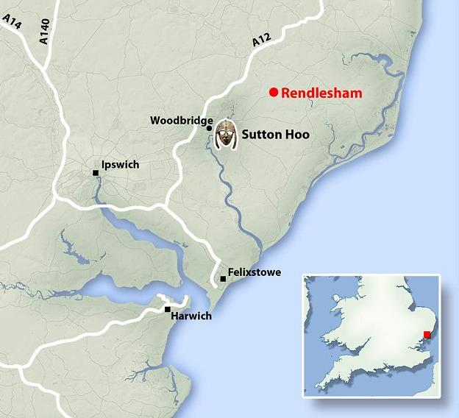
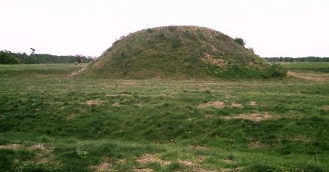
Archaeologists investigated a number of mounds at Sutton Hoo in England.
They found the remains of an Anglo-Saxon ship and a huge cache of seventh-century royal treasure.
Cache: a collection of items stored in a hidden place

Slide 4
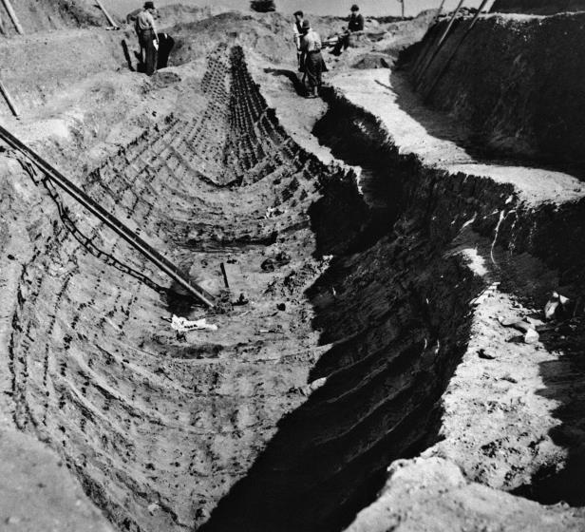
https://www.youtube.com/watch?v=HMKkMi_Wggg&feature=player_embedded

Slide 5
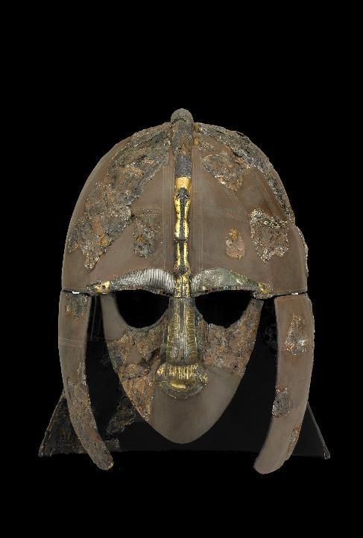
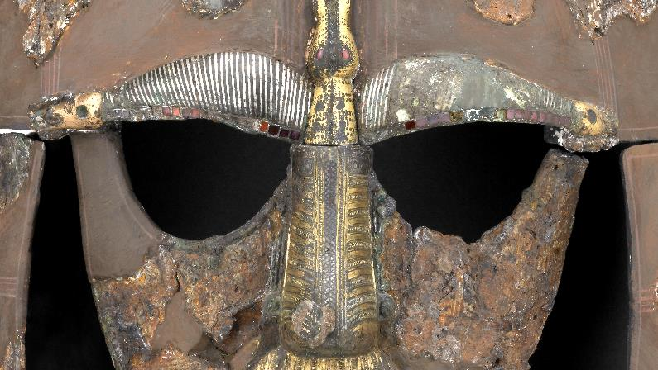
- How old do you think this is?
- Which parts have been better preserved?
- How good would this helmet be at protecting its owner?
- Can you spot the beast on the helmet?
The eyes and wings of the beast are inlaid with garnets which came from India or Sri Lanka!
What does this tell us?
Pause and have a go at the questions!

Slide 6
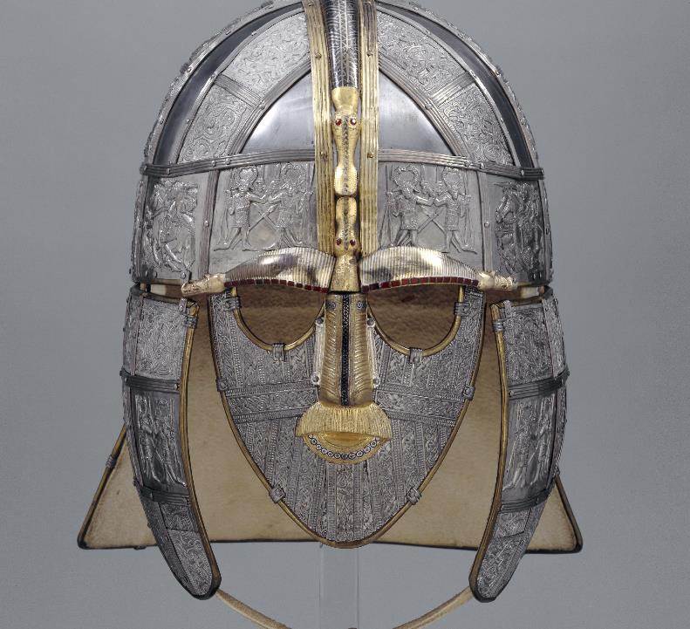
A reconstruction of the Sutton Hoo Helmet

Slide 7
‘The Dark Ages’….really?!?!
Sutton Hoo changed ideas.
The riches found at Sutton Hoo forced many Historians to change their views on the ‘Dark Ages’ (500-1500)
It caused historians to re-think the idea of ‘Dark Age’ following the end of Roman rule and showed that the Anglo-Saxons were capable of great sophistication and had a network of international contacts beyond Britain.

Slide 8

Tasks: Choose one ☺
Chief Archaeologist
You are the lead Archaeologist on the Sutton Hoo Project and the local newspaper have asked you write a small article on the Sutton Hoo Helmet. It must be engaging, historically accurate but accessible to the general public. Best of luck!
Artist’s Impression
Recreate the Sutton Hoo Helmet using your artistic flair. This could an accurate, detailed illustration or something inspired by the dramatic finds at Sutton Hoo.

Slide 9
Further Investigation
Why is the helmet important?
http://www.bbc.co.uk/ahistoryoftheworld/objects/kpnm6FD3TOaNri1gNPGJ1w
Sutton Hoo: A History
https://www.nationaltrust.org.uk/sutton-hoo
Sutton Hoo Helmet: a book by Sonja Marzinzik
https://www.britishmuseumshoponline.org/the-sutton-hoo-helmet.html
Podcast with Neil MacGregor
https://www.bbc.co.uk/programmes/b00t7kyv

Slide 10
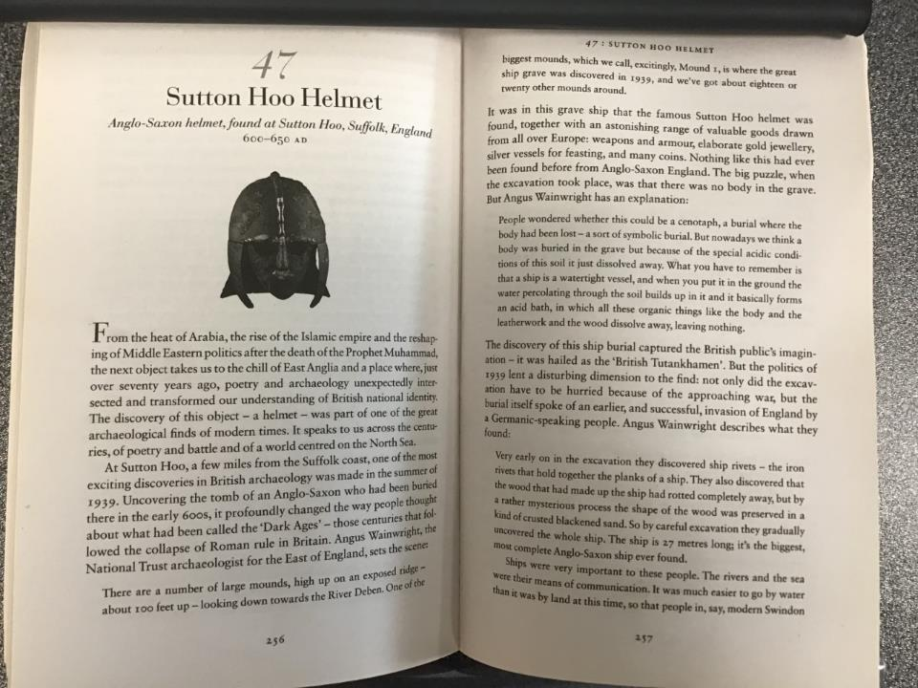
OPTIONAL READING
A History of the World in 100 Objects – Neil MacGregor

Slide 11
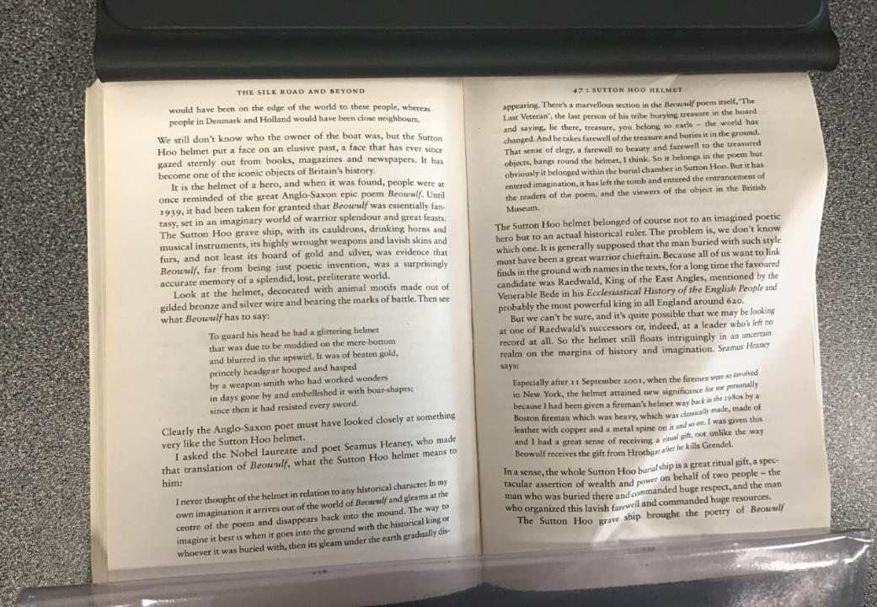

Slide 12
