Slide 1
Welcome to RPE
Notes:
Hello Year Six. We hope that you are all keeping well? You have some exciting times ahead of you as you prepare to start secondary school. As well as exciting it can feel a little bit scary too. To help you all feel happy and confident when you start at Cambourne Village College, we wanted to do a short lesson with you to introduce you to the RPE department, and enjoy a taste of the kind of things we explore in our subject at your new school. When you are ready, let’s get started.

Slide 2
Instructions for Use
You can watch this lesson on video by clicking on this link:
https://www.loom.com/share/30fe987cf9fc4f378b6e2c72602f2a18
Or you can read through this PowerPoint. The teaching is written as notes for each slide. These can be accessed by clicking on the notes icon:

Slide 3
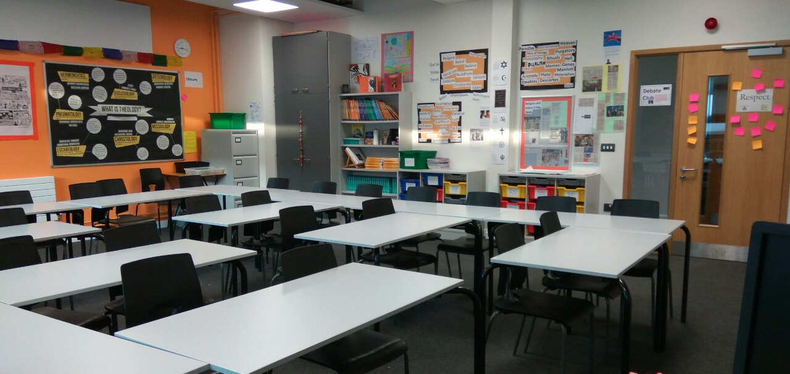
Welcome to our Department
Notes:
For starters this gives you a glimpse into our RPE classrooms. As you can see, the rooms are set up for lots of discussion and fun learning. We deal with lots of different and exciting topics in our lessons and it is important that our rooms make everyone feel comfortable and safe.

Slide 4
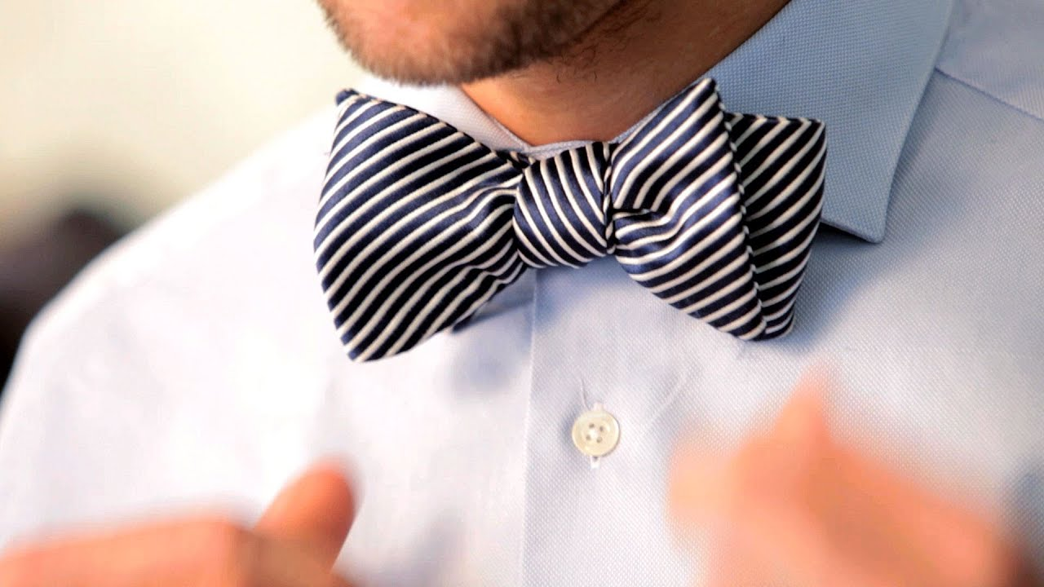
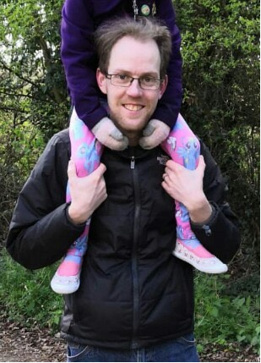
The Teachers
Mr Dover – Head of RPE
Ms Kenton-Howells
Notes:
Well, this is a photo of me. I teach most of the lessons in Year seven, eight and nine RPE. Mr Dover is the other teacher. He is the Head of Department and in charge of everything we do in our department You can easily spot him because he is famous for his bow ties. We are both here to ensure that you enjoy our subject and that you make excellent progress. We even have RPE club which students attend once a week after school if they want to, to develop their learning further in our subject. We are here to help you.

Slide 5
What do we study?
Religion
Philosophy
Ethics
Notes:
Ok, so what do we study? Well RPE stands for Religion, Philosophy and Ethics. We study these three areas in RPE everyday. The study of religion is learning about the main religions of the world. I am sure you have learned about festivals and heard stories form different religions like Hinduism, Buddhism, Christianity for instance? We learn about people and the things they do. We explore how and why they believe and do what they do, and the bigger understanding of the world that this knowledge gives us.
In Philosophy we explore the big questions of life that people have, and we debate them. More of this later. In Ethics we look at the decisions people have to make in their lives. Often they are difficult decisions about what is the right or wrong thing to do in a situation. We look at what different people say is right and wrong and try to understand why they may disagree with each other. You will love RPE if you enjoy learning about people, love having debates, have big questions of your own…

Slide 6
Task 1:
Write the title:
RPE – What is it?
Underneath write the words:
Religion
Philosophy Next to each one write what you will be learning
Ethics
Then:
Write what you think you might like about this subject
Do you have any questions about the subject in Cambourne Village College?
Notes:
Your first task is to do the work on the slide please.

Slide 7
Philosophy
Notes:
So now we know what the subject is, let’s start exploring some of it. Let’s start with Philosophy.

Slide 8
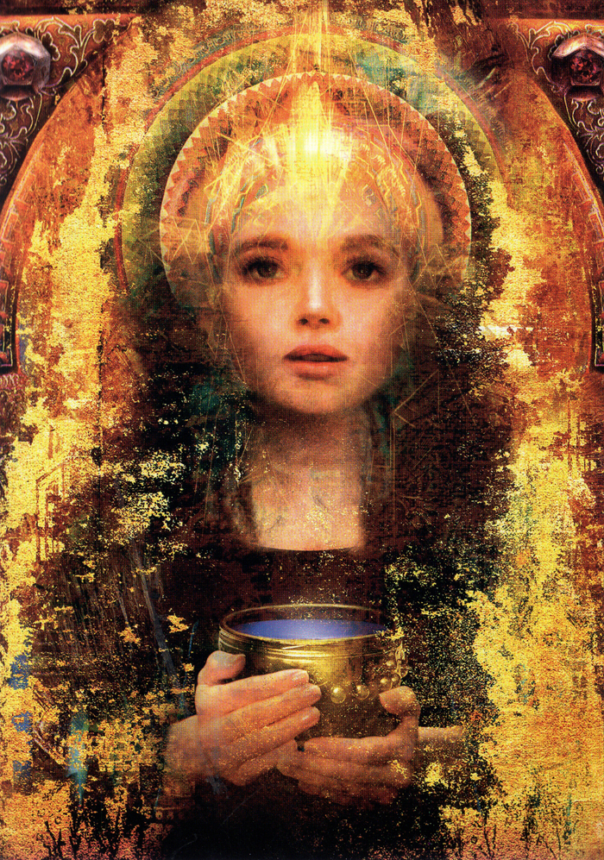
Imagine
What questions would you ask?
Notes:
Imagine I could give you ten minutes with a being who knew everything. A being who knew all of the answers to all of life’s questions. What questions would you want answered? What have you always wanted to know? The picture is an image of Sophia, an ancient goddess of wisdom and knowledge.

Slide 9
Task 2:
Write a list of at least five questions that you would like to ask Sophia if you could have ten minutes with a being who knew everything and could answer all of your questions.
What questions would you love to have the answers to?
Notes:
Here is your next task. If you are working in school you could share and discuss your questions with your class mates. If you are working at home you could do this with the people who are at home with you, if they have time.

Slide 10
What were your questions?
Notes:
So that is Philosophy. Philosophy is a word which comes form two different words: Philia and Sophia. They are ancient Greek words which mean lover of (philia) knowledge (Sophia). Philosophy then is the subject where you ask big questions about life and try and seek the answers. Some of your questions might have been things like “why am I here? What is the meaning and purpose of life? What happens when we die?” These are ultimate questions – they are questions which people will answer in different ways depending on their opinion. No one knows who is actually right. That’s what makes the discussion and debate so exciting and so interesting. The other part of the subject we study is Ethics. Let’s have a look at that now. Let’s do some more thinking.

Slide 11
Ethics
This Photo by Unknown Author is licensed under CC BY
Notes:
The next activity will be a thought problem which gets you to think about what is good or bad, right or wrong. This is Ethics.

Slide 12
Let’s travel to the future….
Notes:
But first, let’s travel to the future……………

Slide 13
Meet Naughtibot
Notes:
I would like to introduce you to an amazing invention of the future. In the future grown ups will be able to buy a “Naughtibot” for their children. Naughtibot has been programmed to read the minds of children. Naughtibot knows exactly what the child they belong to is thinking and planning to do. Naughtibot will stop a child from making mistakes and doing naughty things. This means that children of the future will never need to make mistakes or be naughty.

Slide 14
What do you think?
Notes:
So, do you like the idea of Naughtibot? Would it be an amazing invention? You can talk about this with the people around you and see what they think. Does everyone agree with you? Do you all have different arguments as to whether Naughtibot is a good invention or not.

Slide 15
Task 3:
Draw a picture of what you think Naughtibot would look like
Label your picture showing what features he/she has and what he/she can do
Underneath write what you think the good things about having a Naughtibot would be
Then write a list of what might not be so good about having a Naughtibot
Then write if you would buy one for your children in the future and why. Give reasons for you answers. You can show here too that you have thought about different people’s points of view.
Notes:
Here is your final task.

Slide 16
Well done

