Slide 1
CHALLENGE #2
What is Geography?

Slide 2
Geography is much more than just maps…

Slide 3
Over time, Geographers have helped us to make sense of…
…the physical world
…the human world
…the environmental world
Notes:
Physical world – what our planet is like, the work of rivers, sea, ice, volcanoes…
Human world – how and where people live, develop and earn a living
Environmental world – habitats such as mountains, forests, oceans and how they develop and change. The impact of human activity on the environment.

Slide 4
PHYSICAL GEOGRAPHY
Earthquakes
Volcanoes
Glaciers
Weather
Climate
Rivers
Floods
Coasts
Ice

Slide 5
HUMAN GEOGRAPHY
Development
Living space
Resources
Population
Migration
Countries
People
Money

Slide 6
ENVIRONMENTAL GEOGRAPHY
Habitats
Recycling
Protection
Pollution
Waste

Slide 7
“The study of Geography is about more than just memorising places on a map. It’s about understanding the complexity of our world, appreciating the diversity of cultures that exists across continents. And in the end, it’s about using all that knowledge to help bridge divides and bring people together.”
- Barack Obama
Former President of the United States of America

Slide 8
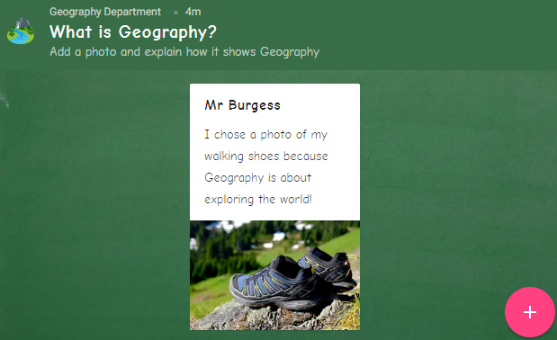
Geography is about our whole world. Can you think of the best way to show what Geography is all about?
INSTRUCTIONS
Find an object (or several objects) that represent Geography OR draw something instead.
Take a photo of the object(s) or drawing.
Go to https://padlet.com/dburgess/whatisgeography. Add your photo and explain how it shows Geography.
An example has been done for you…
There will be a small prize for the best ideas when you’re back in school in Year 7!

